Slide 1
WELCOME

Slide 2
Population And Natural Environment
ELEMENTARY SCIENCE
CLASS- FIVE
CHAPTER-14

Slide 3
Population
The total number of persons inhabiting a country, city, or any district or area

Slide 4
What is Population Density ?
Population Density is the number of people per square kilometre land area.

Slide 5
What is Natural environment ?
Natural environment means all living and non-living things that are natural.Climate, weather, and natural resources that affect human survival and economic activity.These include climate,air,water,energy, radiaton.

Slide 6
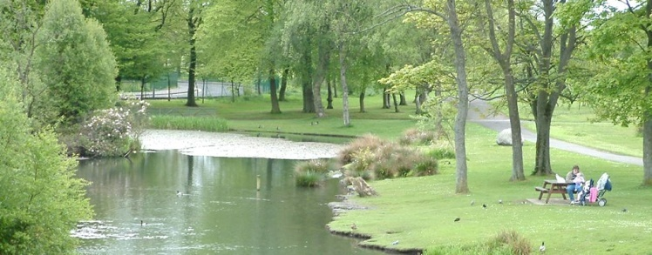
Natural environment

Slide 7
World Population And Bangladesh
Today’s world population : Approximately 700 crore which was only 100 crore in early 18th century.
The Population of Bangladesh was 14 crore 97 lac 72 thousands and 364 ( In 2011).
Total area of our motherland Bangladesh is 147570 square kilometres.
So our population density is very high in comparing to other country.

Slide 9
Population of Bangladesh

Slide 10
Over Population of Bangladesh

Slide 11
Over Population of Bangladesh

Slide 12
Over Population of Bangladesh
Our high population density affects directly on environment.
More people need more food, house, land for cultivation.
Population growth makes people easy to get diseases so less medical facilities.

Slide 13
Impact of Population Growth on Environment
Clearing the forest due to need of land for housing and cultivation ,roads and industries etc.
Loss of forest directly affects the eco system.

Slide 14
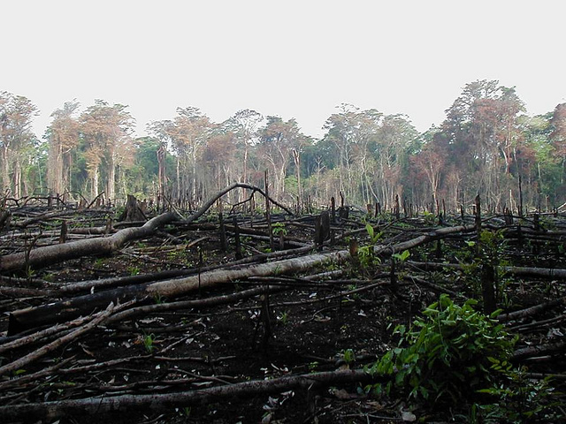
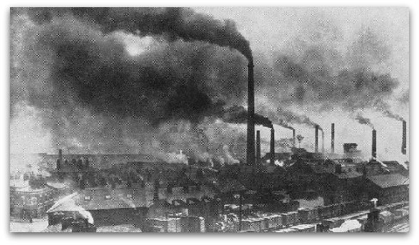
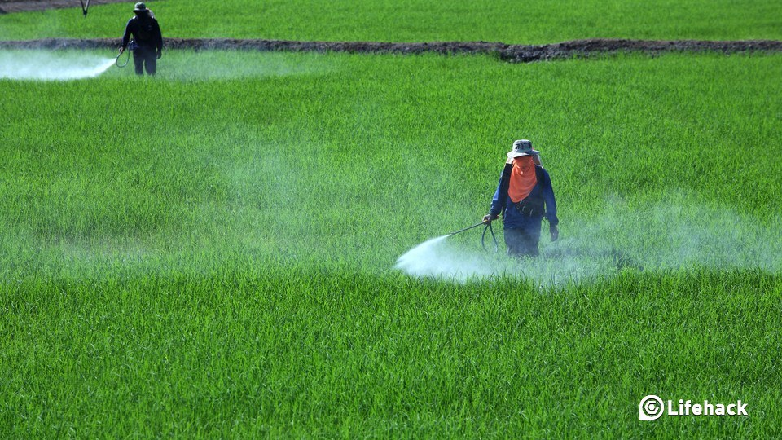
Effect of Population Growth on Environment

Slide 15
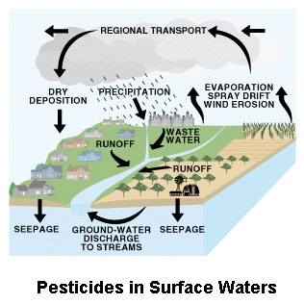

Slide 16
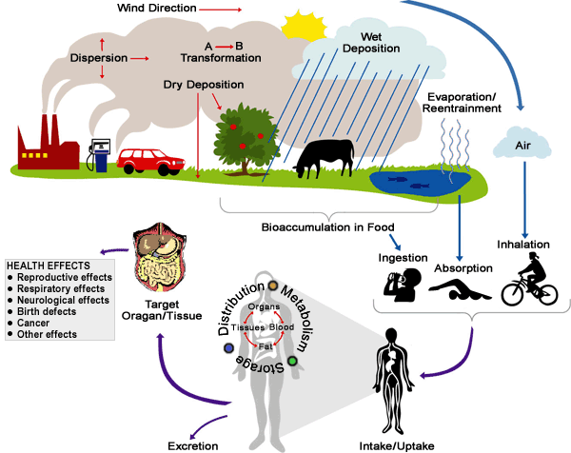
Effect of Population Growth on Human

Slide 17
Role of Science and Technology to Solve Population Problem
Science help to produce more food by invention of hybrid seed, pesticide and agricultural machinery.
Biotechnology is the field of science which helps to grow more nutritious, disease resistant and more productive plants.
Science and technology can help people to use less non-renewable resources, save energy, and reduce pollution.

Slide 18
Role of Science and Technology to Solve Population Problem
Science helps to develop a new concept ---hybrid car for transportation.
So Science and technology play a vital role to solve various problems related to population growth.

Slide 19
Topics to Discuss:
Population
Population Density
Natural environment
World Population And Bangladesh
Over Population of Bangladesh
Population growth and human needs
Impact of Population Growth on Environment
Role of Science and Technology to Solve Population Problem

Slide 20
Thank You

