Slide 1
Welcome

Slide 2
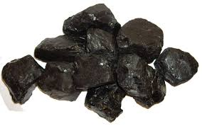
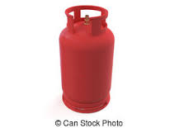
Coal, Gas & Oil

Slide 3
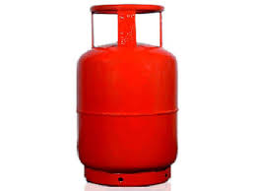
Elementary Science
Class Five
Chapter 13
Natural Resources

Slide 4
Topics to discuss
Natural Resources
Man-made Resources
Natural resources of Bangladesh
Renewable and non­renewable natural resources
Use of solar energy
Prospects of wind power as alternative energy sources
Resource limitation and planned using
The ways to conserve resources

Slide 5
Natural Resources
The materials that we use from the nature are called the natural resources.
Example-Soil, Water, Air, Plants, Animals, Coal, Natural gas, oil, Sunlight etc.

Slide 6
Natural Resources (Coal, Natural gas & oil)

Slide 7
Man-made Resources
Man-made resource is a resource that is made by people.
Man-made resources also come from nature.
Paper, plastic, glass and electricity are examples of man-made resources.

Slide 8
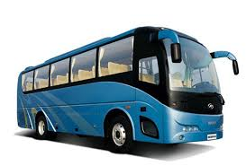
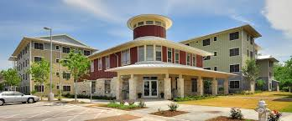
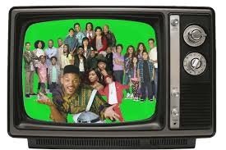
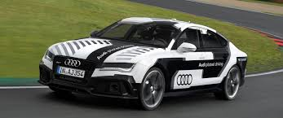
Man-made Resources

Slide 9
Natural Resources of Bangladesh
Natural Resources | Natural Resources
Plain Lands | Sea
Haor | Various Plants & Animals
Beel | Natural Gas
Forests | Coal
Mountain | Oil
Rivers | Lime etc.

Slide 10
Natural Resources of Bangladesh
The natural resources of the country includes the above slide. Due to geographical location there is good possibility of getting more natural resources deep in the soil and under the sea.

Slide 11
Renewable natural resources
Some natural resources can be used
again. These are called renewable
resources.
Example- plants, animals, water, air
etc.

Slide 12
Non­-renewable natural resources
There are some natural resources
that can not be used again. These
are known as non-renewable
resources.
Example- natural gas, petroleum, coal and different minerals etc.

Slide 13
Use of solar energy
One of the alternative energy source
for Bangladesh is solar energy.
Solar panel can covert solar energy to electricity.

Slide 14
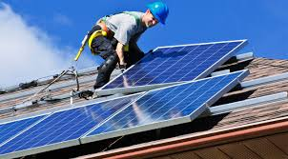
Solar Panel

Slide 15
Use of solar energy
The electricity captured from solar
panel is used in houses, offices of
Dhaka city and even in irrigation
pump.
Some calculator can utilize
solar energy.

Slide 16
Use of solar energy
Solar panel can be used in the remote
villages for electric light, television,
refrigerator, computer etc.
Though these facilities are for the day time but by using storage battery night time electricity is made available.
The most important point is there is no
damage to the environment for using
solar panel.

Slide 17
Prospects of wind power as alternative energy sources
Air is available throughout the earth as it is a source of energy.
Many countries are generating electricity from wind energy by using Wind Mill.
There is great opportunities in Bangladesh to produce electricity from wind energy.

Slide 18
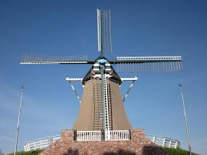
Wind Mill

Slide 19
Resource Limitation and Planned using
The natural resources are limited and thus we have to be careful to use it.
Some of them are non-renewable. Such as- oil, coal, natural gas etc.
Scientists predict that all non-renewable natural resources may be exhausted by next 100 years.

Slide 20
Resource Limitation and Planned using
Thus we have to be careful to use non­-renewable energy sources.
We have to use more heat, solar, wind and water energy sources.
Besides we need to invent new energy sources for future uses.

Slide 21
The ways to conserve resources
Peoples are now aware of environmental conservation.
Saving environment and planned resources use are known as environmental conservation.

Slide 22
The ways to conserve resources
It can adopt different techniques and methods for resource protection and reduction of pollution by less resources uses or avoiding excess use of resources.
Besides reuse or reproduction of resources could be other measures to be taken.

Slide 23
Thanks to All

