Slide 1
Welcome

Slide 2
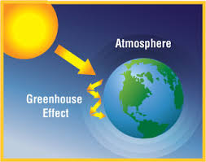
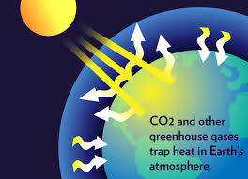
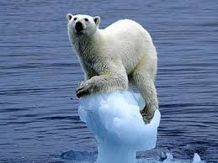
Stop Greenhouse Effect & Global Warming
“Save the Earth”

Slide 3
Elementary Science
Class Five
Chapter 12
Climate Change

Slide 4
Topics to discuss
Climate and climate change
Causes the global warming
Green-house gases and green-house effect
The impact of climate change in Bangladesh
The ways of prevention of climate changes and Global warming
Adaptation to climate changes

Slide 5
Climate
Climate is the average or entire
weather condition of an area over
many years.
*The climate of Bangladesh is warm and humid.

Slide 6
Weather of Bangladesh
Bengali Month | Type of Weather
Poush and Magh | Cold
Boishakh and Joistha | Warm
Ashar | Rainfall
Srabon and Vadra | Hot and rainy
Poush | Cold

Slide 7
Climate change
Climate change may refer to a change in average weather conditions due to increase the overall temperature of the earth gradually. The way of such increase of temperature is known as global warming. The climate of this earth is changing due to this global warming.

Slide 8
Causes the global warming
The main cause is the increase of carbon dioxide (CO₂) in atmosphere
Burning of woods, coals, petroleum and natural gases in factories and vehicles
Deforestation
No more plantation

Slide 9
Green-house gases
carbon dioxide (CO₂)
water vapor (H₂O)
methane (CH₄)

Slide 10
Effect of Green-house gases
Green-house gases absorb the heat from the sun. Too much increase of these gases in the atmosphere can capture more heat. This in turn increase the level of temperature of the earth every year. The way of such increase of temperature is known as global warming.

Slide 11
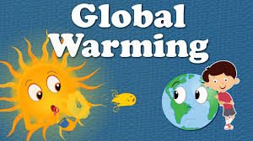
Green-house Effect

Slide 12
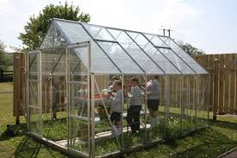
Green House Project (Result of the investigation & explanation on textbook)

Slide 13
The impact of climate change in Bangladesh
The increase of earth temperature resulting raising of the sea level of the earth due to the melting of ice in the mountain peaks and polar areas.

Slide 14
The impact of climate change in Bangladesh
If the way of temperature and sea water increases at the present rate the coastal area of Bangladesh will be under water in near future.

Slide 15
The impact of climate change in Bangladesh
The salt water of the sea will enter into the rivers. Besides natural disaster like flood, cyclone and tidal surge will be more frequent in the coastal area.

Slide 16
The ways of prevention of Climate changes and Global warming
To emit less carbon dioxide (CO₂) and removal of carbon dioxide from the atmosphere.
By reducing the use of coal, petroleum and natural gases.

Slide 17
The ways of prevention of Climate changes and Global warming
To increase use of renewable energy sources like solar energy, air turbine, bio fuel etc.
Less use of electricity and natural gases can produce less carbon dioxide.

Slide 18
The ways of prevention of Climate changes and Global warming
Need more plantation of trees. Plants can use up carbon dioxide to produce their food.

Slide 19
Adaptation to Climate changes
The measure to survive in the changing climate is called climate change adaptation. The adaptation is to lower the risks against actual or expected climate change effects.

Slide 20
Adaptation to Climate changes
Adaptation activities
developing the infrastructure such as houses, schools and factories
constructing of flood and cyclone shelters
creating coastal afforestation

Slide 21
Adaptation to Climate changes
Adaptation activities
innovating salt tolerant crops
changing our lifestyle
disseminating knowledge of climate change

Slide 22
Thanks to All

