Slide 1
WELCOME

Slide 2
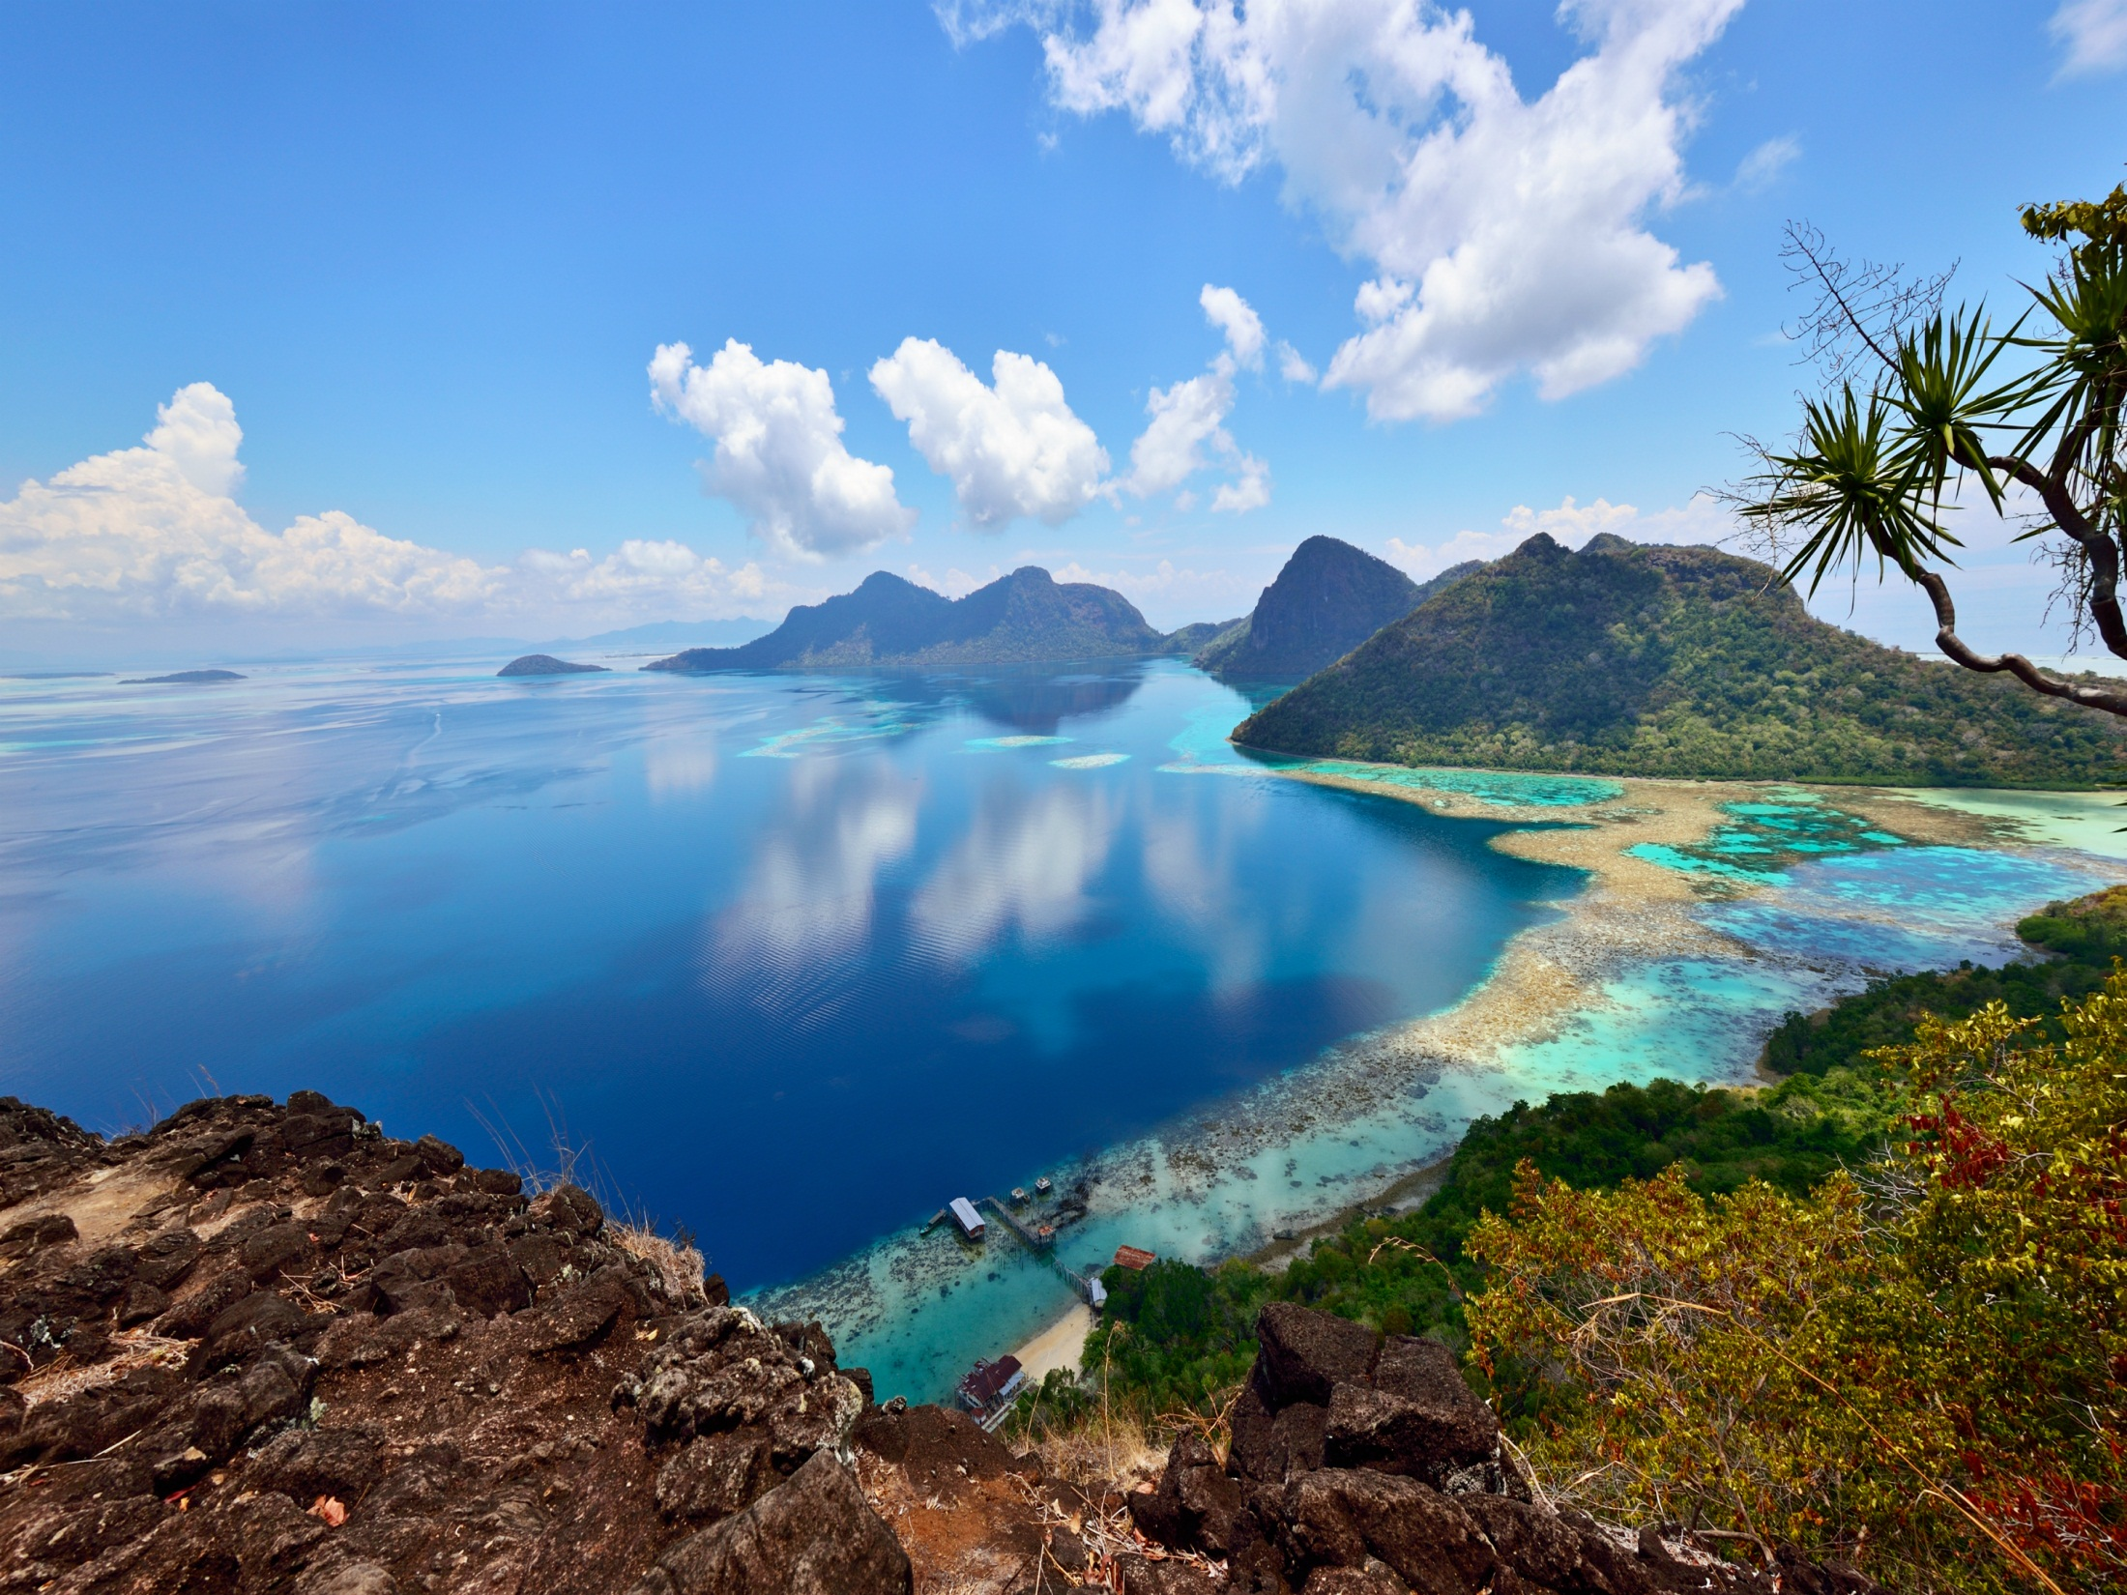
Elementary science
Class: Five
Chapter 11
Weather and Climate

Slide 3
Topics to Discuss
Weather and Climate
Relationship between Weather and Climate
Air Pressure and Wind
Low and High Air Pressure
The Components of Weather and Climate
Extreme Weather

Slide 4
Weather and Climate
Weather
Weather is the condition of sky and the atmosphere of a place for a short time.
Climate
Climate is the general condition of weather of a place for many years.

Slide 5
Relationship between Weather and Climate
Weather and climate are not the same, though there is a close relation between them. Climate is the changes of usual weather pattern in a certain area.

Slide 6
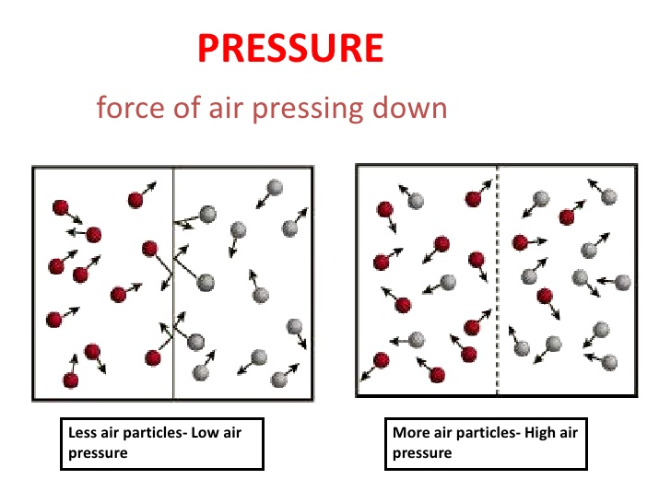
Air pressure
Air pressure is the force produced by the weight of the air pressing down on the earth surface.

Slide 7
Wind
Wind blows from high pressure to low pressure area.

Slide 8
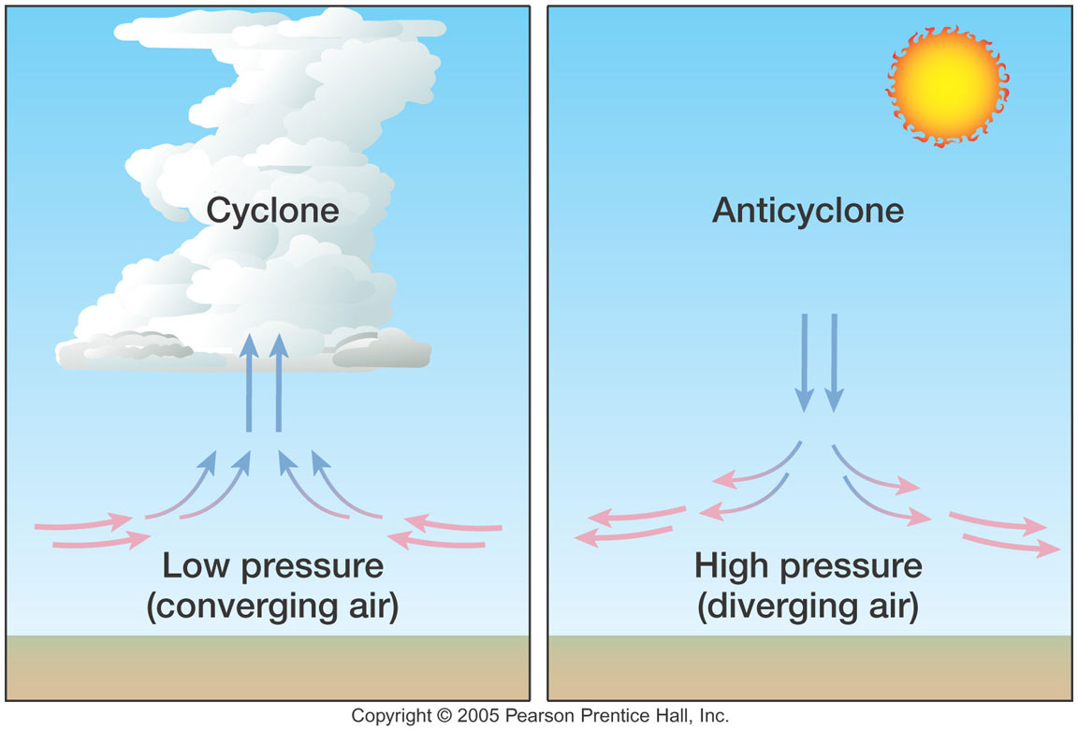
Low Pressure and High Pressure

Slide 9
Low Pressure and High Pressure
Low Pressure
During the day time, land is warmer than the water and the warmer land warms the air above. Air that is warmed becomes lighter than the surrounding air, so it rises up. As a result, low pressure develops over the land. On the other hand, at night low pressure develops over the ocean

Slide 10
Low Pressure and High Pressure
High Pressure
During the day time, air over the ocean is cooler and heavier so it sinks. Then high pressure develops over the ocean. At night, the land is cooler than the ocean. Therefore, high pressure develops over the land.

Slide 11
Low Pressure and High Pressure
In rainy season i.e. June – August, the land of Bangladesh is warmer than the Bay of Bengal. In winter season i.e. December – February, the land is cooler than the Bay of Bengal. These seasonal temperature contrasts of the land and the ocean develop high and low pressure systems. It produces monsoon wind system.

Slide 12
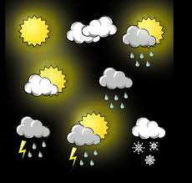
The Component of Weather and Climate
The elements of both weather and climate are same. These are temperature, humidity, wind, cloud, rain and air pressure.

Slide 13
Humidity

Slide 14
The Components of Weather and Climate
Humidity is the measure of how much moisture is in the air. The lower the humidity, the lesser the moisture in the air. During rainy season, the monthly average humidity and rainfall is higher than those in other months.

Slide 15
Extreme Weather
Each of the weather components changes all the time. When one of the weather components changes beyond a normal range, we experience the extreme weather.

Slide 16
Extreme Weather
Some Common Extreme weather Conditions
Heat Wave and Cold Wave
Flood and Daught
Nor’wester (Kal – Baishakhi)
Tornado
Cyclone

Slide 17
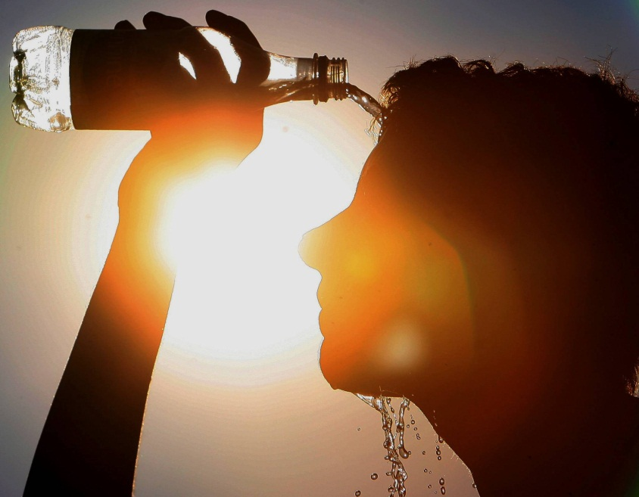
Extreme Weather
Heat Wave
A heat wave is a prolonged period of excessively hot weather.

Slide 18
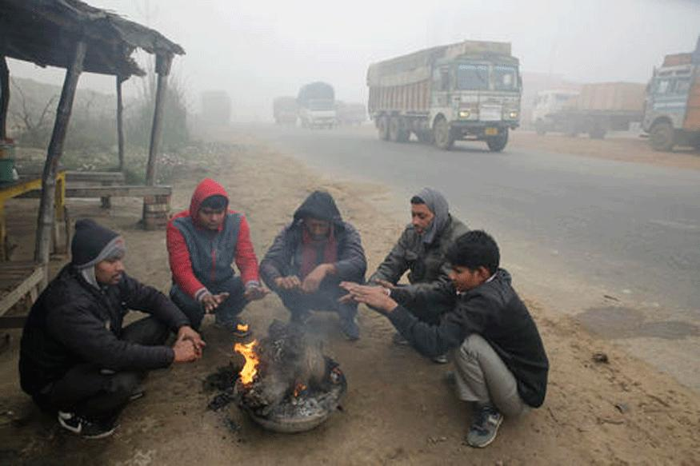
Extreme Weather
Cold Wave
Occurrences of extreme low temperature in association with incursion of dry cold winds from north into our country are known as cold waves.

Slide 19
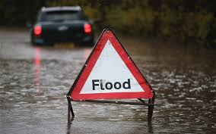
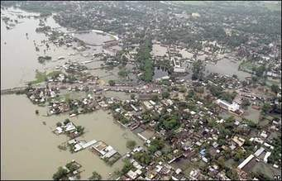
Extreme Weather Flood
In every rainy season about one –fifth of Bangladesh flooded, and extreme years, two-third of land can be submerged in floodwater. It is because of our topography and climate.

Slide 20
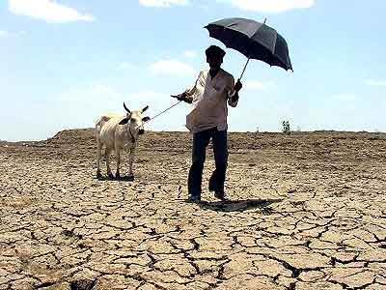
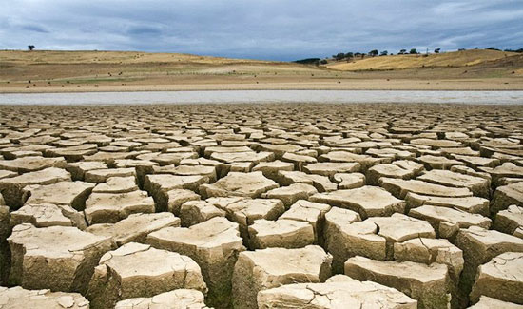
Extreme Weather Draught
A usually long period of dry weather is called as drought.

Slide 21
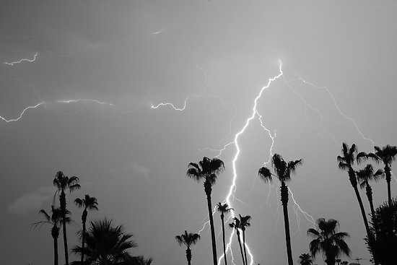
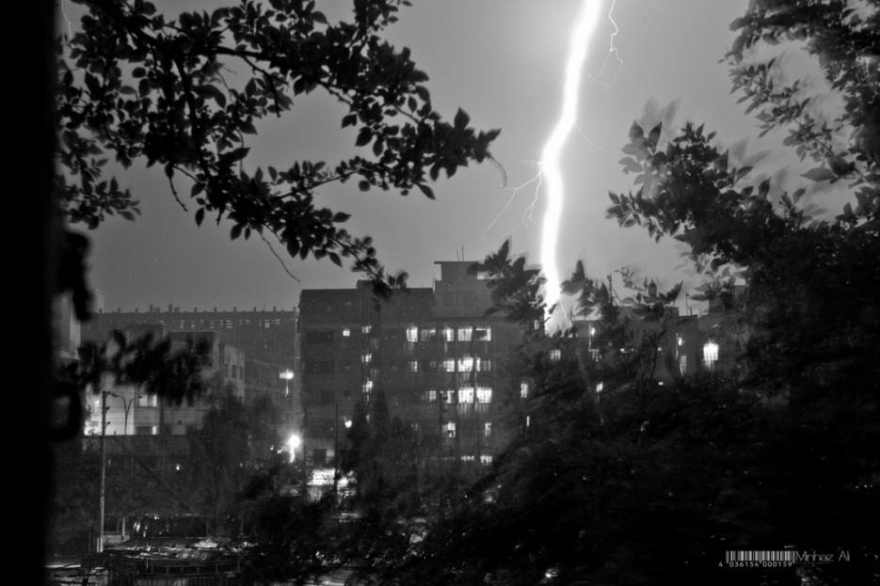
Extreme Weather Nor’wester (Kal – Baishakhi)
A thunder storm which is common during Summer in our country is known as Nor’wester or Kal-Baishakhi.

Slide 22
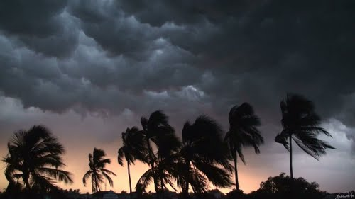
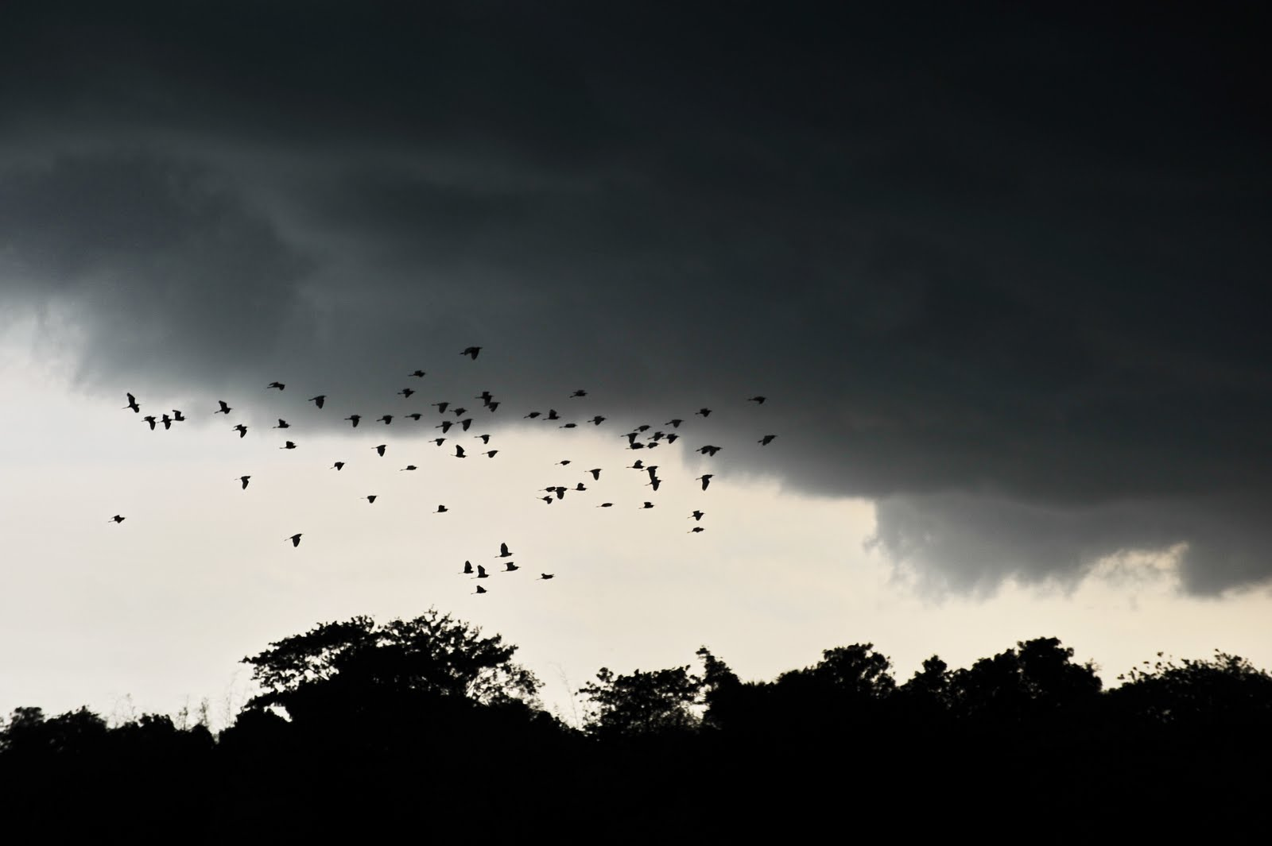
Extreme Weather Nor’wester (Kal – Baishakhi)
Nor’wester grows by surface heating.
It is more frequent in the late afternoon.

Slide 23
Extreme Weather Tornado

Slide 24
Extreme Weather
Tornado
Tornado is a narrow, violent, funnel-shaped column of spiral winds.
This wind extends downward from a cumulonimbus to the ground.
The size of tornado is usually less than 1 km.
The very strong wind due to tornado can even destroy well- built structures.

Slide 25
Extreme Weather Cyclone

Slide 26
Extreme Weather
Cyclone
Cyclone is a large low pressure system and a revolving storm that consists of numerous thunderstorms.
The size of the cyclone is 500 – 800 km. Cyclones are created by getting heat and water vapor from the warm Indian Oceans and the Bay of Bengal.
Sometime strong surge is created due to cyclone.

Slide 27
THANKS TO ALL

