Slide 1
WELCOME

Slide 2
Elementary Science
Class Five
Chapter Ten
Information in our life

Slide 3
Topics to Discuss
Information
Information Sharing
Importance of Information Sharing
ICT helps us to share information easier
Information Collection
Information Store
Information Exchange

Slide 4
Technology
computer
laptop

Slide 5
What will happen if we do not know the information?
Make a table like the one shown below
Information | What will happen ?
Share your idea with your classmates

Slide 6
Information sharing is important for us

Slide 7
Information sharing helps us to prevent harm

Slide 8
ICT helps us to share information easier

Slide 9
What is ICT?
Information and Communication Technology (ICT) is common tool that help people share information.
ICT makes easier-
To communicate others.
To collect, store, exchange, spread or use information.
Example: internet, e-mail, TV, radio, mobile- phone
Internet: The internet is a huge network of computers together all over the world.

Slide 10
How to Collect Information through Internet?

Slide 11
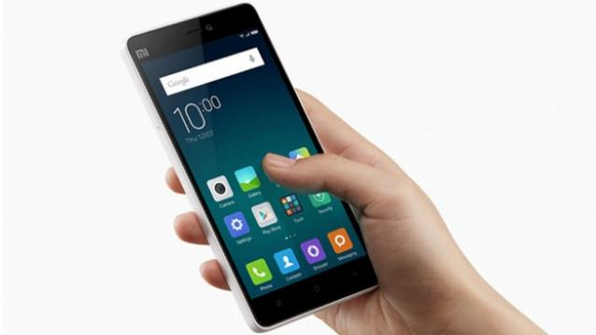
computer
laptop
We can collect information
through Internet by using computers
or mobile-phone.
by using books, newspaper, TV
or radio.
mobile phone

Slide 12
How to Collect Information through Internet?
The followings are the basic steps for collecting information through the internet:
Use search engines such as Google, Yahoo or Pipilika.
Type keywords relevant to the topic you are searching for into the ‘search bar’ and click ‘search’ or press ‘enter key’ on your keyboard.
Search through the list of web pages to find the information you need.
Repeat above 3 steps as necessary, or choose new keywords that are more or less specific and thus search the information you need.

Slide 13
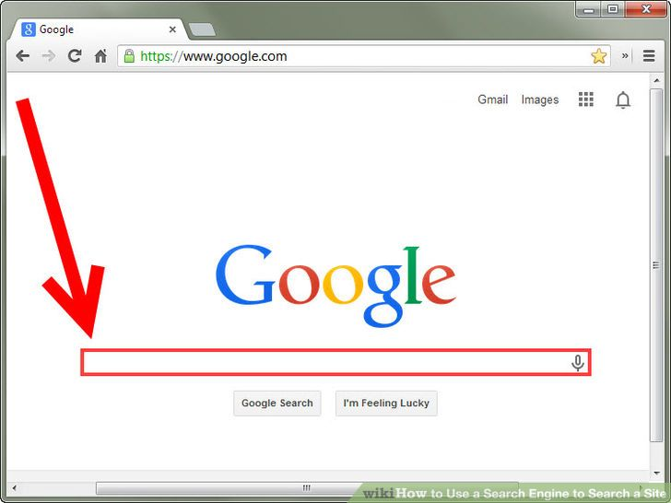
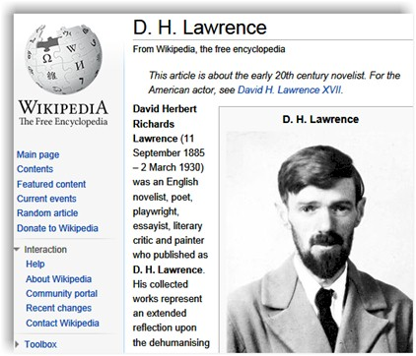
Search engine: Google
website

Slide 14
How to store information?

Slide 15
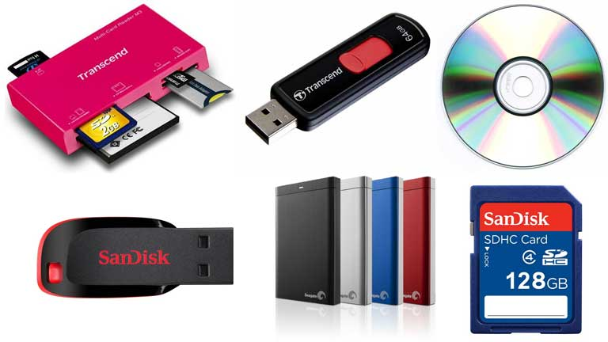
Pen drive
CD
Memory card reader
Pen drive
Portable hard disc
Memory card
Information storing devices

Slide 16
How to Exchange Information
using Technology?

Slide 17
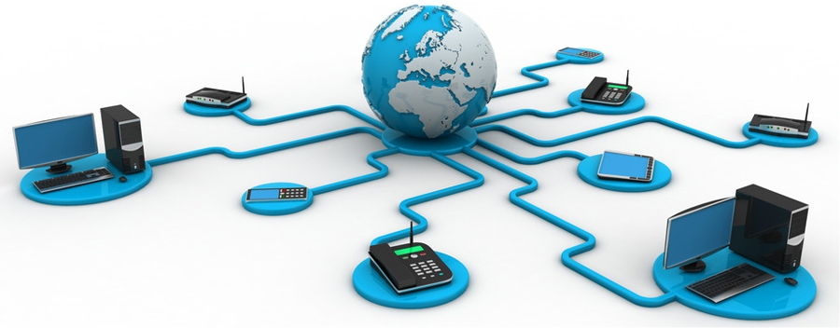
How to Exchange Information Using Technology

Slide 18
How to Exchange Information using Technology
You can exchange information by printing or
copying the information in other’s portable memory.
You can also exchange information using
internet through
E-mail
Short Message Service(SMS)
Social Networking Service(SNS): Facebook, Twitter

Slide 19
Home Work:
What is Information?
How does information help us?

