Slide 1
WELCOME

Slide 2
Elementary Science
Class Five
Chapter Nine
Technology
in our life

Slide 3
Topics to Discuss
Use of Science and Technology
Science
Step of Scientific Methods
Technology and its Example
Relationship between Science and Technology
Agricultural Technology
Mechanical Technology
Chemical Technology
Biotechnology
Negative Effects of Technology

Slide 4
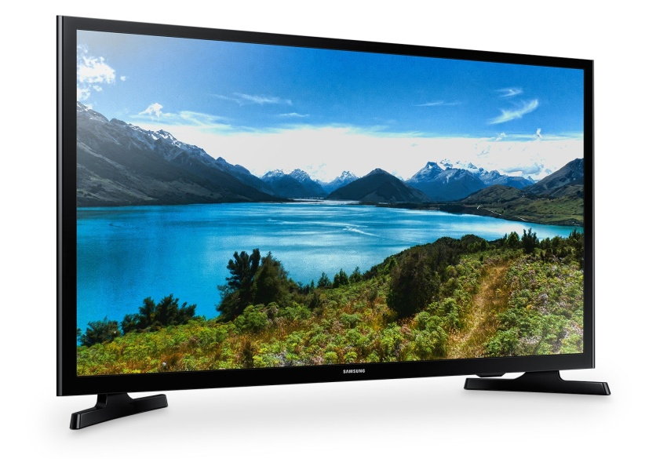
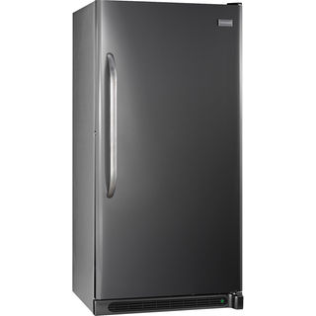
Let’s see some picture
All of these are results of science and technology

Slide 5
Use of Science and Technology
What to do:
Make a table like the one shown below
situation | technology | Science knowledge
Transportation | car | Heat, mechanical energy
Medical Care
Agriculture
House
Share your idea with your classmates

Slide 6
Science:
Science is the knowledge or study about the natural world. It is based on the facts learned through observation and experimentation.
Steps of Scientific Method:
Observation
Question
Hypothesis
Experiment
Conclusion
Sharing

Slide 7
Technology:
Technology is the practical application of science to solve the practical problems of our life.
Example:
Refrigerator, TV, mobile and light

Slide 8
Relationship between Science and Technology:
Science Technology
People invented steam engine by applying scientific knowledge of steam power.
Technology Science
Microscope is used to know microbial
knowledge.
Telescope is used to know space knowledge.

Slide 9
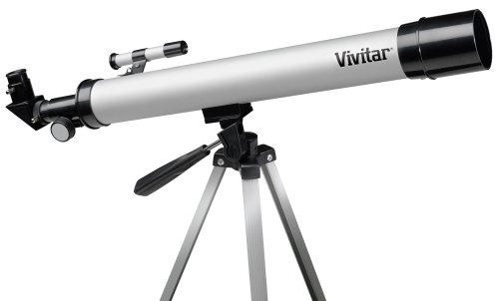
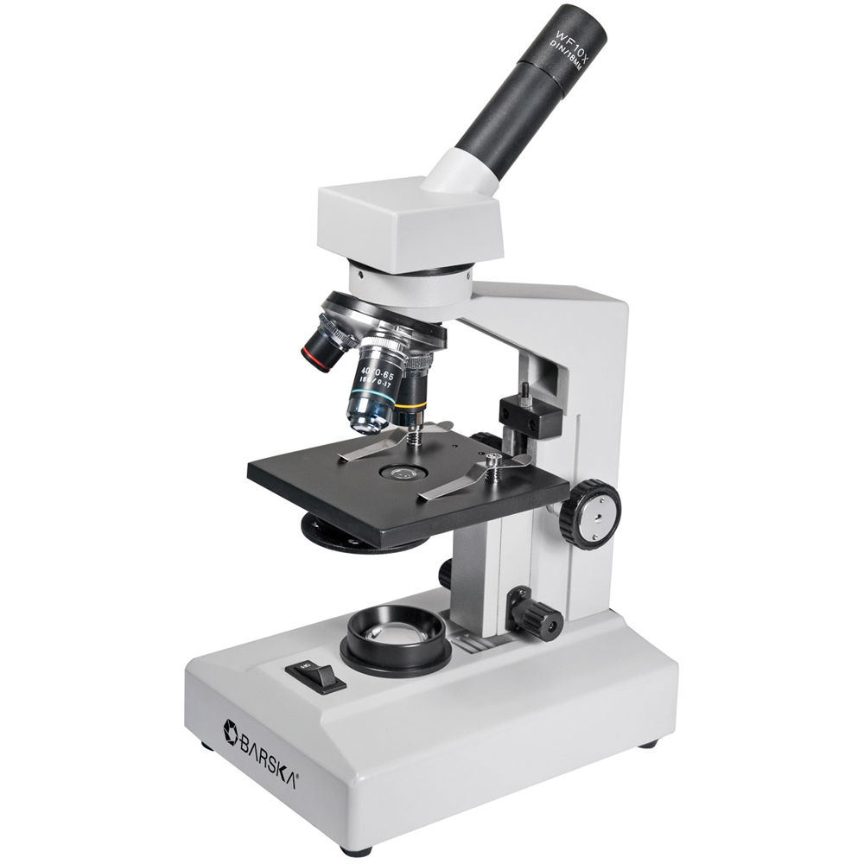
Space telescope
Microscope

Slide 10
Agricultural
Technology

Slide 11
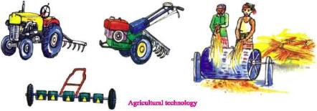
Let’s see some picture
Agricultural Technology

Slide 12
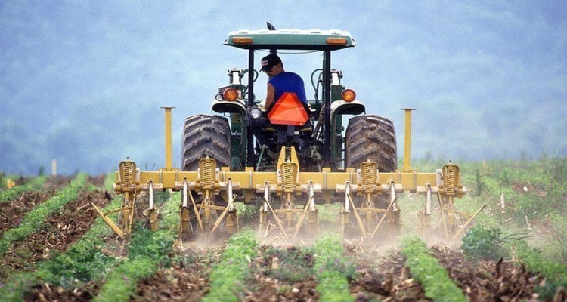
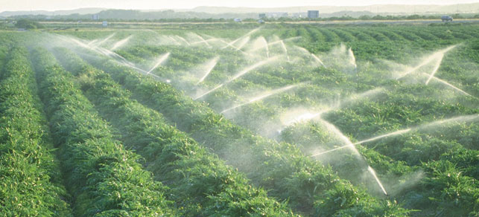
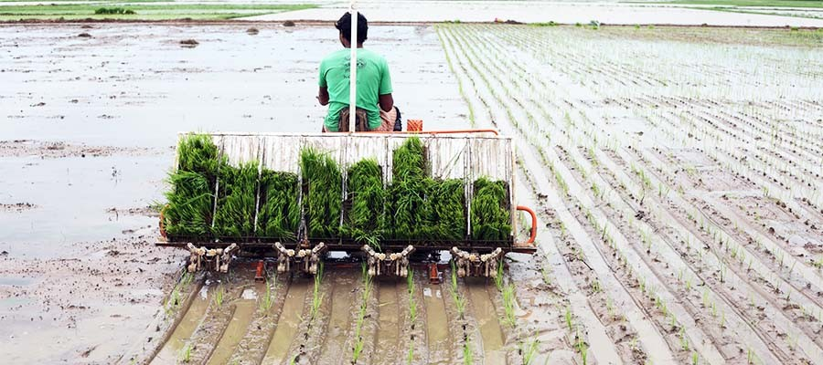
Mechanical Technology
It helps to produce a lot
of food in the shortest
period of time.
Tractor
Irrigation pump
Drum seeder

Slide 13
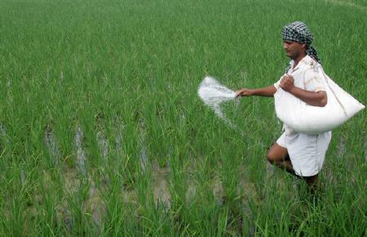
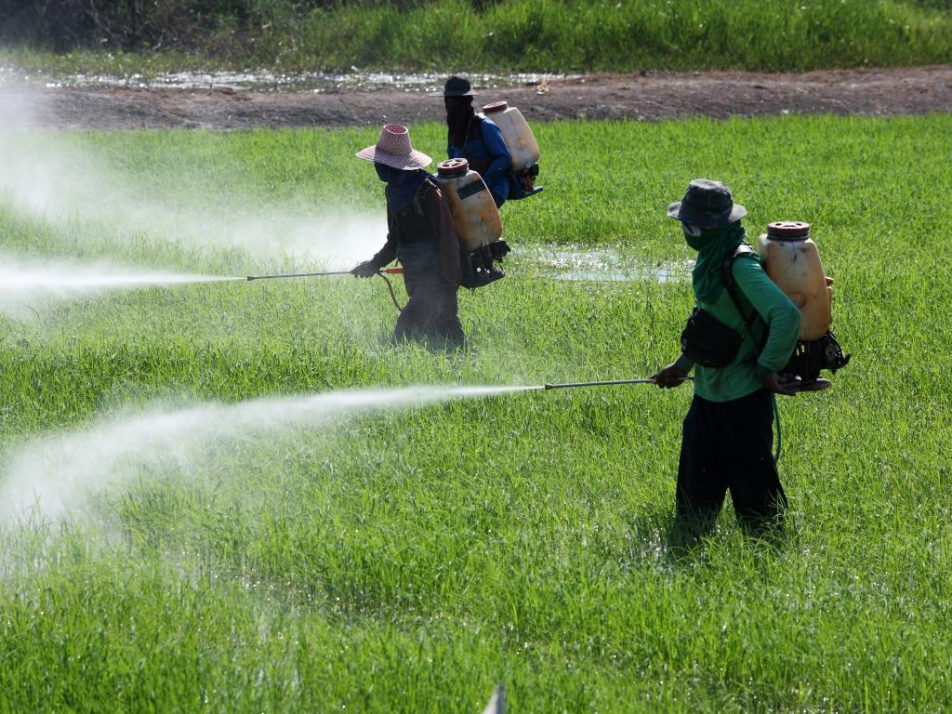
Chemical Technology
The fertilizer helps plants to grow well and produce more food.
Using fertilizer
Pesticides are used to resist harmful pests and weeds in order to grow more food.
Using pesticides

Slide 14
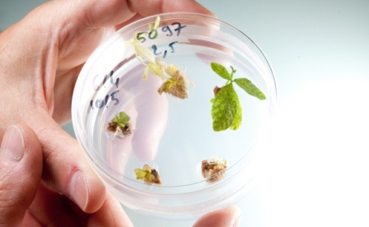
Biotechnology
A technology that uses
living things to make
new product for human
welfare.
A way to make plants
with special qualities.
More nutritious
More resistant to
pests
More productive
Biotechnology can create new crops

Slide 15
H.W.
How does agricultural technology help to produce food?
Make a chart like the one shown below
agricultural technology | how does it help produce food
Mechanical Technology
Chemical Technology
Biotechnology

Slide 16
Negative Effects
of
Technology

Slide 17
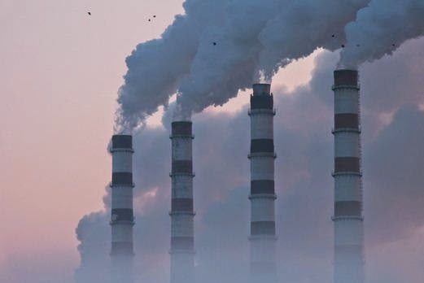
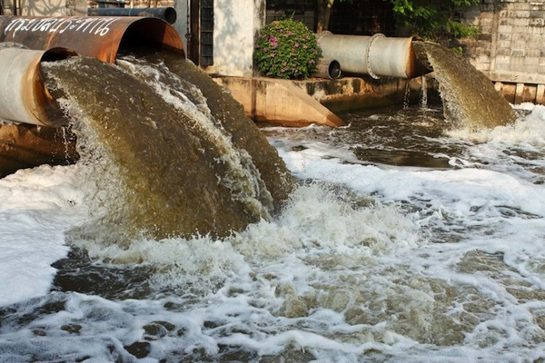
1.Environmental Pollution
Air pollution
Water pollution

Slide 18
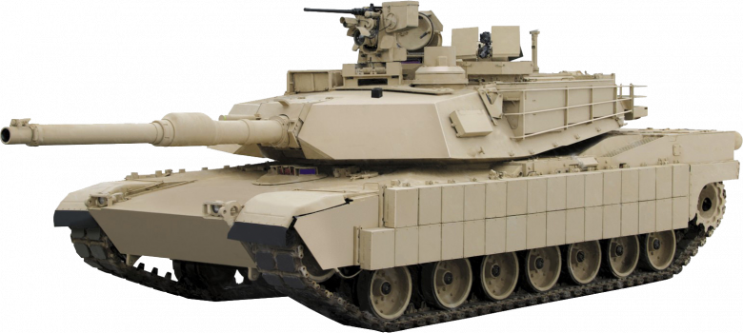
2. Weapon
Horrible uses of science knowledge
are improving weapon technology.
tank

Slide 19
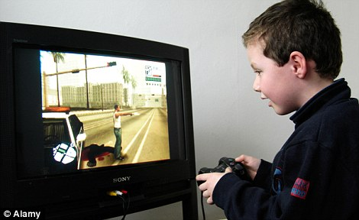
3.Other Negative Effect
Technology hurdles --
our regular sports
physical exercise
limit free thinking
Using technology turned to an addiction

Slide 20
Home Work:
What is Science?
What is Technology?
Give an example-
How does technology use science?
How does science use technology?

Slide 21
H.W.
What are the Negative effects of
Technology
Make a chart like the one shown below
Negative effects of technology

Slide 22
Thanks to All

