Slide 1
WELCOME

Slide 2
Elementary Science
Class Five
Chapter Seven
Chapter : Healthy Lifestyle

Slide 3
Topics to discuss:
Infectious disease
Ways of spreading infectious diseases
Types of infectious diseases
Prevention and cure of infectious diseases
Puberty

Slide 4
?????
What is infectious Disease?
Infectious diseases are the diseases that caused by the entrance of germs such as Bacteria, Viruses, Fungi into the body.

Slide 5
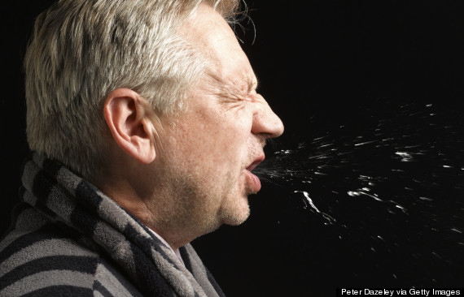
Ways of Spreading Infectious Diseases
Coughs or sneezes

Slide 6
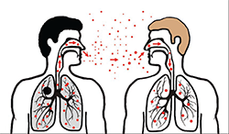
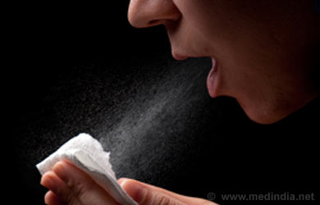
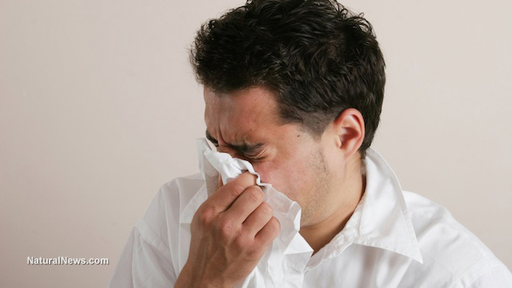
Coughs or sneezes

Slide 7
Ways of Spreading Infectious Diseases
Bites of insects or animals

Slide 8
Ways of Spreading Infectious Diseases
Through air when someone coughs or sneezes.
By using utensils of an infected person.
By biting of insects or animals.
By eating contaminated food or water.

Slide 9
EVALUATION
Class Work: What is infectious disease?(written)
Home Work: Make a list of ways that infectious disease spreads.

Slide 10
Airborne Disease (Chicken pox)

Slide 11
???????
Water borne disease(Typhoid)

Slide 12
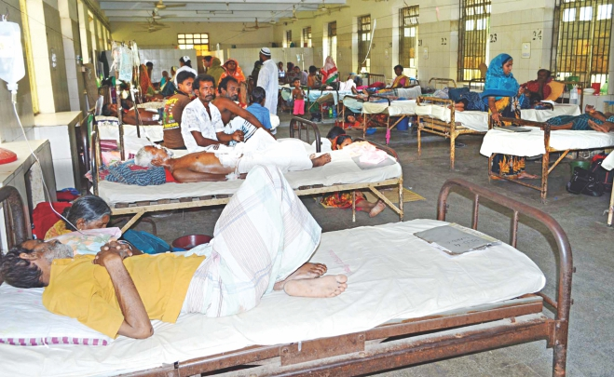
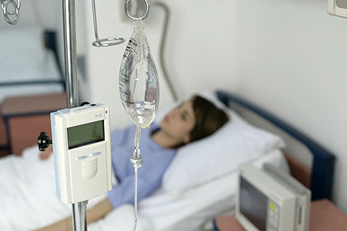
?????
Malaria (Insect Transmitted)
Rabies (Animal Transmitted)

Slide 13
Types of Infectious Diseases
Airborne diseases:
Swine flu, measles, chicken pox, tuberculosis, influenza etc.
Waterborne diseases:
Diarrhoea, cholera, dysentery, typhoid etc.
Contact diseases:
Direct contact: Flu, Ebola, measles etc.
Indirect contact: AIDS- caused by HIV virus.
Diseases transmitted by animals and insects
Rabies- through bites of rabies infected dog.
Malaria and dengue- by mosquito bites.

Slide 14
EVALUATION
Class Work: Write down the name of five infectious diseases.
Home Work: Write down the name of ten infectious diseases and their type.

Slide 15
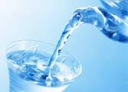
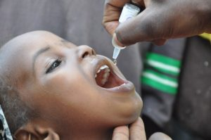
Preventive Steps
Keeping environment clean
Using safe water
Covering face with tissue
Taking vaccine

Slide 16
The Ways to Prevent Infectious Diseases
By eating balanced diet.
By using safe water.
By washing hands regularly.
By adequate ventilation in our room.
By covering face during coughs or sneezes.
By keeping environment clean.
By removing objects that hold water such as tub, tyre or canister.
By getting vaccination.
By avoiding unhygienic food.

Slide 17
How to Cure Infectious Diseases?
RELAX!

Slide 18
How to Cure Infectious Diseases?
Taking nutritious food

Slide 19
How to Cure Infectious Diseases?
Treatment

Slide 20
How to Cure Infectious Diseases?
By taking rest.
By eating nutritious.
By drinking enough safe water.
By taking medicine.
To see a doctor.

Slide 21
Evaluation
Class Work: How can we prevent infectious Disease?
Home Work: How can we prevent MALARIA by removing object holding water like bowl, tyre etc?

Slide 24
What is puberty?
PUBERTY IS THE TIME IN A LIFE WHEN OUR BODY BEGINS TO DEVELOP AND CHANGE FROM THE BODY OF A CHILD TO THE BODY OF A TEENAGER.
PUBERTY STARTS :
BETWEEN AGE ( 8-13) IN GIRLS
BETWEEN AGE (9-15) IN BOYS.

Slide 25
Changes in the Body during Puberty
Pimples on the face

Slide 26
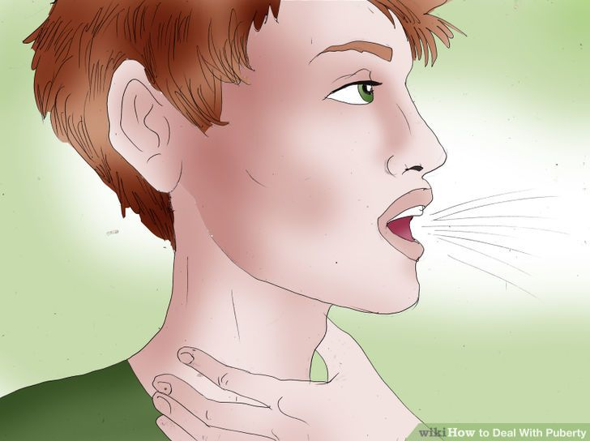
Changes in the Body during Puberty
Well shaping of muscles
Changing of voice

Slide 27
Changes in the Body during Puberty
Both girls and boys:
Growing taller
Changing shape of body
Sweating more
Getting oilier skin
Pimples on face
For boys:
Changing of voice
Well shaping of muscles
Getting beard and moustaches

Slide 28
Taking care of during puberty…
Washing clothes
Taking bath regularly

Slide 29
Taking care of during puberty…
CLEANLINESS

Slide 30
Taking nutritious food

Slide 31
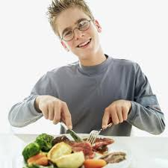
Taking nutritious food.

Slide 32
Taking care of during puberty…
Don’t be over sensitive
Don’t be upset easily
Maintaining personal hygiene
Taking nutritious food
Talk to parents, teachers or elder brothers or sisters

Slide 33
Evaluation
Discuss about puberty with your parents
Thanks all

