Slide 1
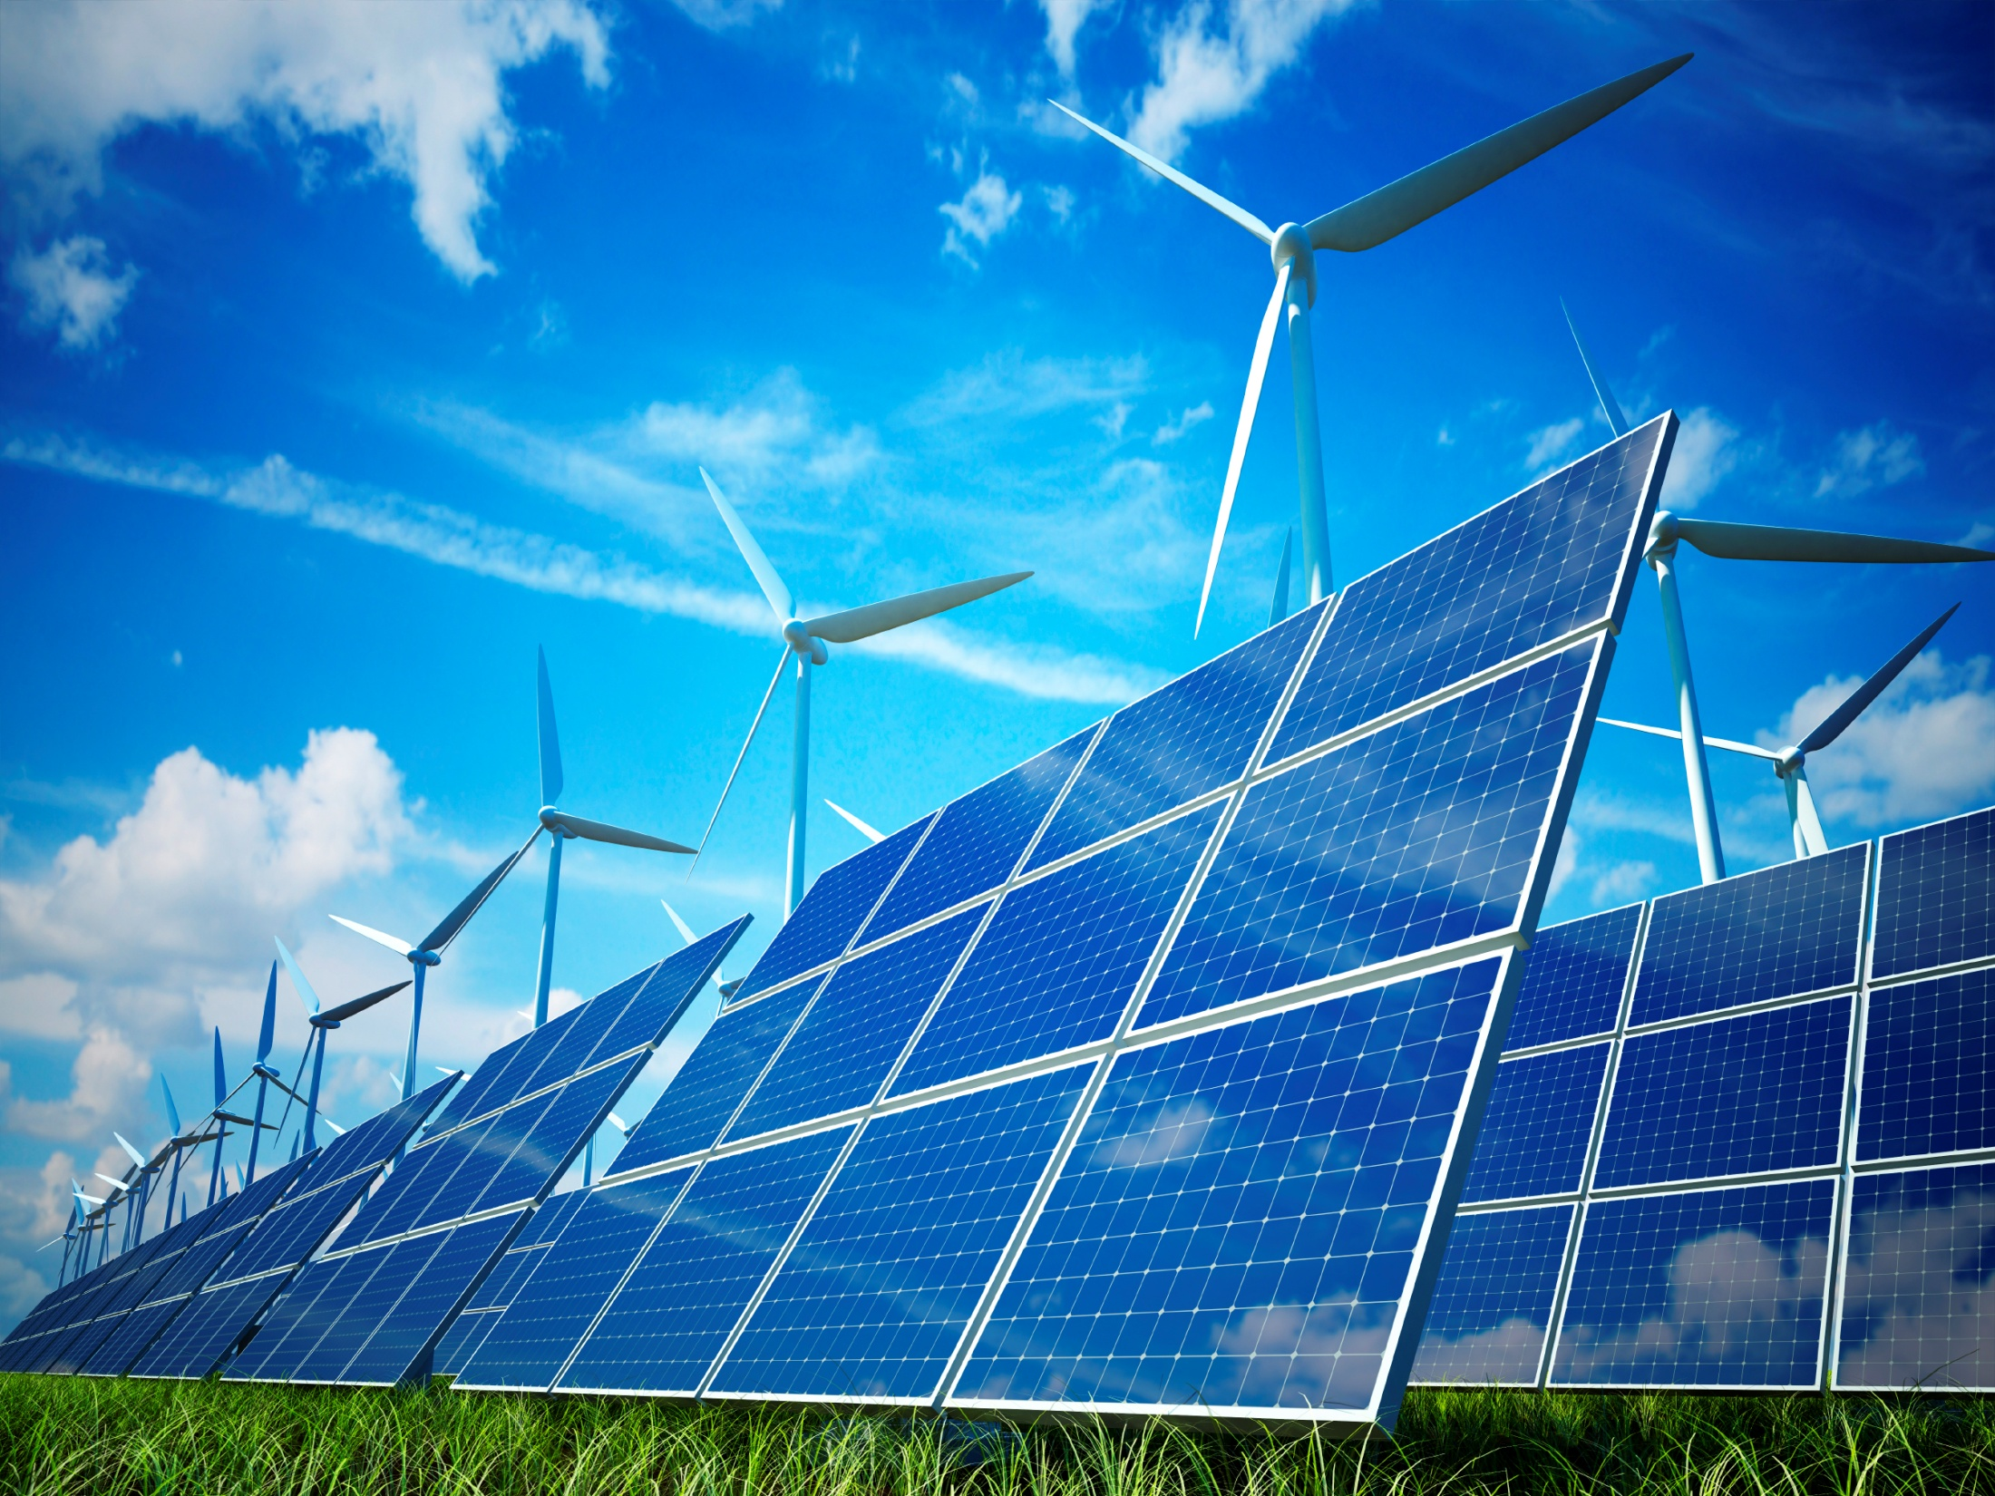
WELCOME

Slide 2
ELEMENTARY SCIENCE Class: Five
Chapter 5
Energy and Matter

Slide 3
Topics to Discuss
Energy
Energy around us
Forms of energy
Sources of energy
Transformation of Energy
Transfer of Energy
Transfer of Heat
Transfer of light
Proper Use and Saving Energy
Structure of Matter
What makes up a matter
States of matter

Slide 4
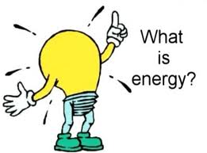
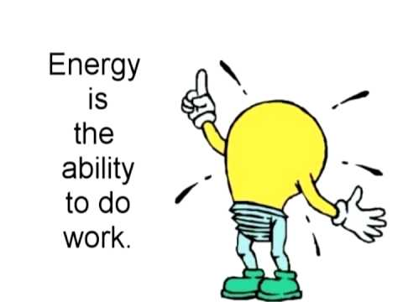
1. Energy

Slide 5
(1)Energy around us
We use energy in everything that we do.
To walk to school (muscle energy)
To ride a bicycle (muscle energy)
To run a computer (electrical energy)
To cook our food (thermal energy)
To run a car (chemical energy)
To see something (light energy)
To talk and hear (sound energy)

Slide 6
Energy can change form or position of something.

Slide 8
Forms of Energy
Electrical Energy:
Used to run electrical appliances such as fan, TV, electric bulb, washing machine etc.
Mechanical Energy:
Moving object has this form of energy.
Example:
Wind: It can run windmill.
Moving car

Slide 9
Forms of Energy
Light Energy:
It helps us to see.
It can pass through transparent matter: water, glass etc.
Sources: sun, candle, fire, electric light etc.
Thermal Energy (Heat Energy):
It is a form of energy.
It gives us the sensation of hot or cold.
Sources: sun, stove, fire etc.

Slide 10
Forms of Energy
Sound Energy:
It helps us to hear.
It comes from vibration of objects.
It needs medium to travel: air, any matter etc.
It can not travel in vacuum.
It is used to enjoy music.
Chemical Energy:
It stores in in food, fuel(wood, oil, gas), coal etc.

Slide 11
Sources of Energy
We get heat, light, electricity, sound energy from the following sources:
Food
Coal
Oil
Water current
Wind
Battery
Generator
The Sun (the main source of all energy)

Slide 12
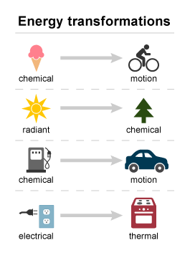
(2)Transformation of Energy
Energy can be changed from one form to another. The change of energy from one form to another is known as energy transformation.

Slide 13
Question: How does energy changes its form?

Slide 14
Transformation of Energy:
Example:
1.We get solar energy directly as light and heat. When plants make food by themselves, they change the light energy from the Sun to chemical energy.
2.When animals eat plants as food, they change the chemical energy stored in plants to heat energy and mechanical energy.
3. Solar panels can change light energy of the sun into electrical energy.
4. When we switch on TV, electrical energy is changed into light, heat and sound energy.

Slide 15
Energy Transformation in Our Daily Life

Slide 16
(3)Transfer of Energy
Energy can be transferred from one place to another in
many different ways.
(1) Transfer of Heat:
Transfer of Heat is the flow of thermal energy from warmer place to cooler place. Thermal energy is transferred through three different processes:
i. conduction
ii. convection
iii. radiation
Question: How does thermal energy transfer?

Slide 17
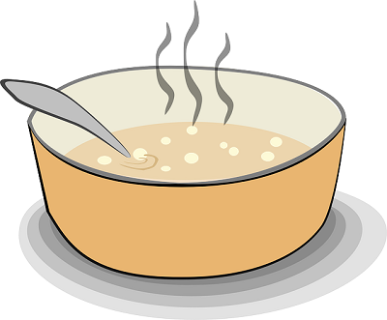
(1) Transfer of Heat(Conduction):
Transfer of heat through solid matter is called Conduction.
For example:
If we place a metal spoon in the hot water, soon it begins
to feel hot. This is because the spoon is heated by hot
water, and then heat spreads to the colder end of the
spoon.

Slide 18
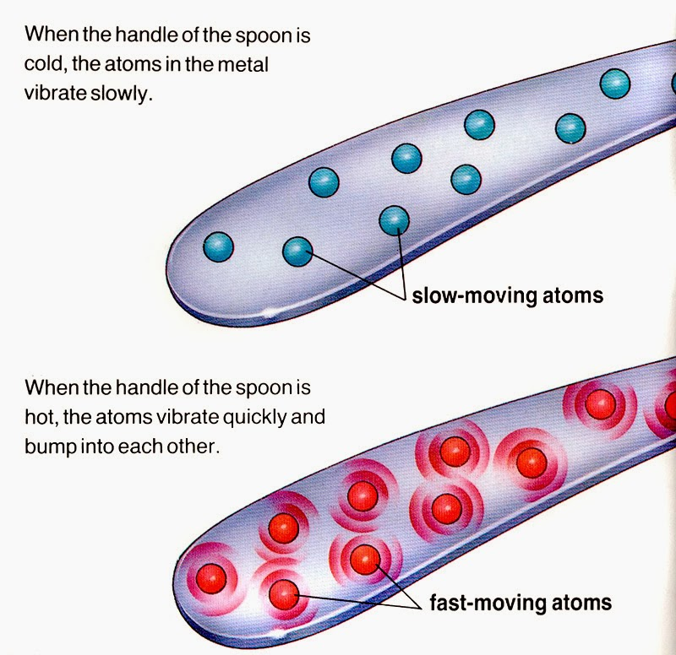
(1) Transfer of Heat(Conduction):

Slide 19
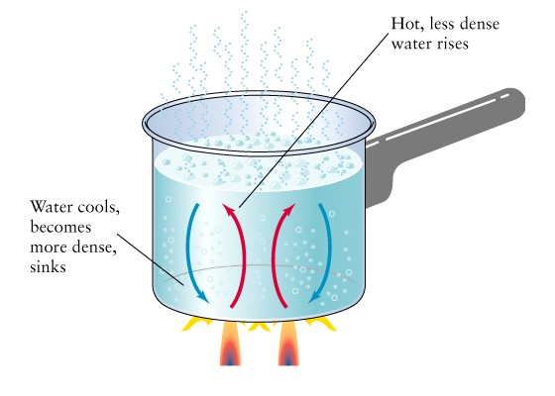
(1) Transfer of Heat( Convection):
Transfer of heat energy through the gases and liquids is
called convection.
For example:
When we put a pot of water on a stove, the heated water
near the bottom of the pot rises to the top of water.
Instead, the cold water near the top sinks to the bottom
of the pot, and then it is heated and rises to the top.
Through this process heat is spread from top to bottom
of the pot.

Slide 20
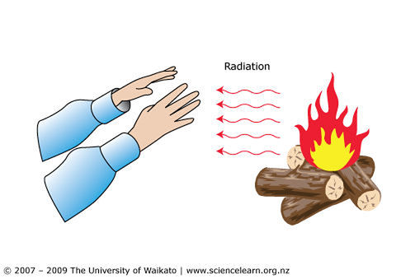
(1) Transfer of Heat(Radiation):
Radiation is the process in which energy emitted from a
source without any medium.

Slide 21
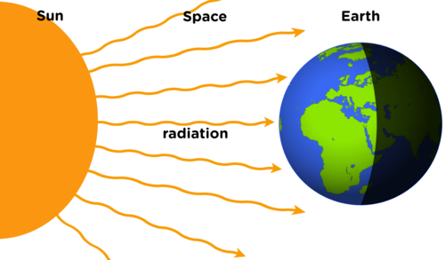
(1) Transfer of Heat(Radiation):
Conduction can work through solid, and convection
can work through liquids and gases, but radiation can
even work without solids, liquids and gaseous
medium.
This is why we can feel the heat of the Sun even though
it is millions of kilometers away in space. With the same
process we feel the heat from fire or light bulbs.

Slide 22
Transfer of Heat
Transfer of Heat

Slide 23
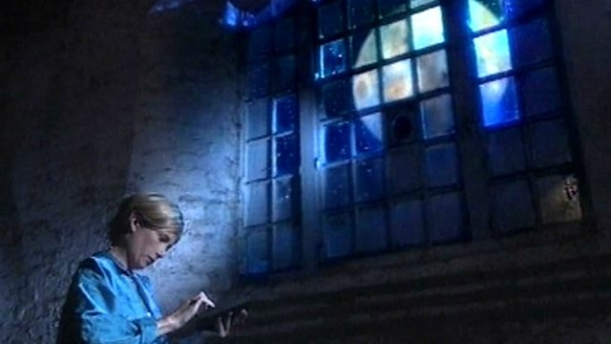
(2)Transfer of Light
Light is the form of energy that helps us to see.
Light travels as radiation.
Light can transfer without any medium such as solids, liquids, and gasses.
Light does not need any medium to transfer.
Light from the Sun, Moon, and stars reaches the Earth through radiation.

Slide 24
(4) Proper Use and Saving of Energy
Why is Saving Energy Important?
We use energy in many works everyday. Most of the energy we depend on come from non-renewable energy resources such as oil, coal, and natural gas. They cannot be replaced once we use them up. Therefore, we have to use energy resource wisely. Wasting energy is not good for the environment and can cause pollution.
By saving energy we can help to preserve energy resources and prevent pollution.

Slide 25
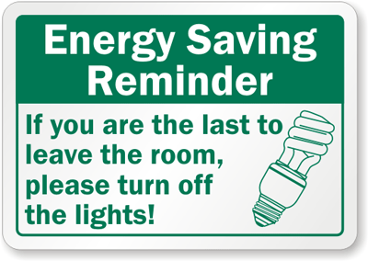
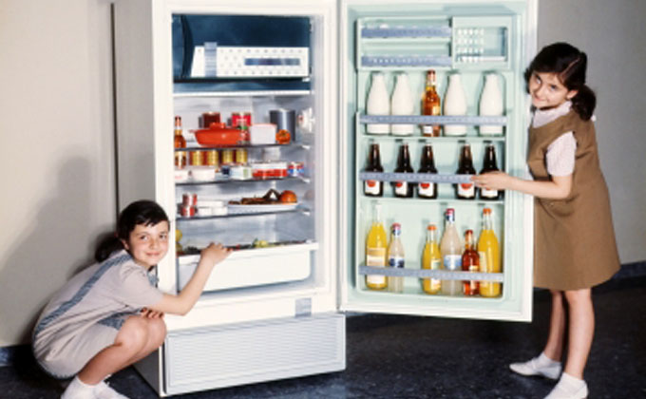
How to save energy
Open the curtain to get sunlight
Close the refrigerator door as soon
as possible
Plants trees to give shade

Slide 26
How to Save Energy
Question: How we can save energy?
Here are a few ideas of what we can do to save more
energy:
Turn off lights and appliances when we are not using them.
Do not leave the refrigerator door open any longer than we need to.
Plants trees to help shade houses on hot summer days.
Open the curtains and use the sunlight instead of turning on the lights.
Walk or use bicycle instead of using car as much as possible.

Slide 27
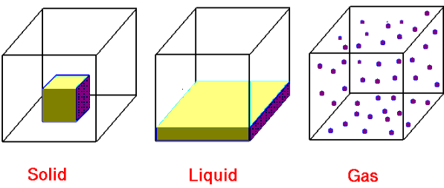
2. Structure of Matter
MATTER:
Matter is anything that has weight and takes up
space.
Everything around us is matter even the things that we cannot see such as air.

Slide 28
2. Structure of Matter What makes up matter:
Atom:
All matter is made up of very tiny particles that we cannot see with the naked eyes. Those tiny particles are called atom.
hydrogen atom
oxygen atom
ATOM

Slide 29
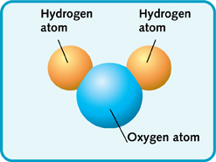
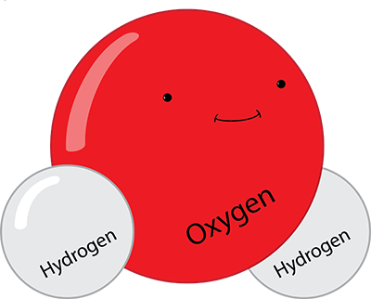
2. Structure of Matter Molecule:
Two or more atom makes molecules.
A molecule is a group that is made up of two or more atoms joined together.
A matter is the collection of innumerable molecules.
Water molecule

Slide 30
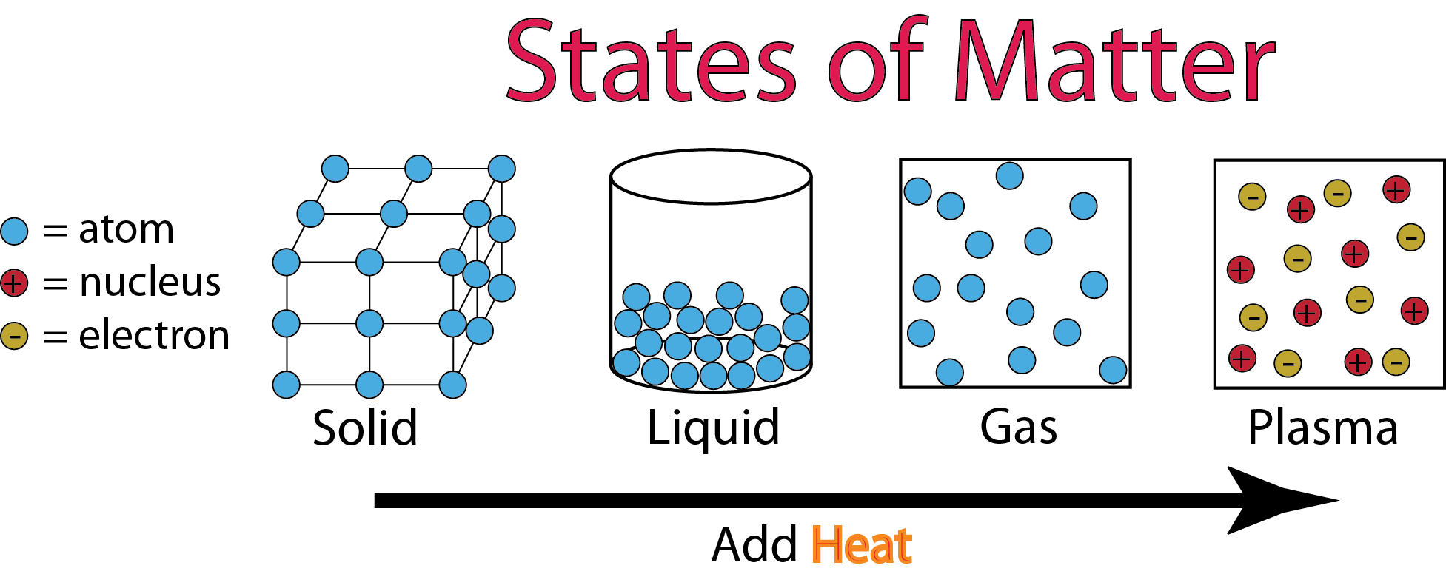
2. Structure of Matter State of Matter
Matter can exist in three states such as
solid
liquid
gases
The state of a matter depends on
the arrangement of molecules of that matter.
the bonding between the molecules of that matter.

Slide 31
2. Structure of Matter State of Matter
Example : Water
Water is a liquid matter.
It consists innumerable water molecules .
Properties of Different States of Matter:
Solid(ice):
i. It has definite shape and volume.
ii. In solid, the molecules are closely
bound to one another in place.
iii. Molecules cannot move about.

Slide 32
2. Structure of Matter State of Matter
Properties of Different States of Matter:
2. Liquid(water):
i. It has definite volume but doesn’t
have definite shape.
ii. In liquid, the molecules are always
in motion.
iii. In liquid, the molecules are quite
close together, but have a little
space to move around.

Slide 33
2. Structure of Matter State of Matter
Properties of Different States of Matter:
3. Gas(water vapour):
i. It has no definite shape and volume.
ii. In gas, the molecules are
spread very far apart.
iii. In gas, the molecules are randomly
arranged and are constantly
moving freely at high speed.

Slide 34
Changes of State of Water

