Slide 1
WELCOME

Slide 2
ELEMENTARY SCIENCE
Class: Five
Chapter 4
Air

Slide 3
Topics to Discuss
Air
Use of Wind
Use of Air
Air Pollution
Causes of Air Pollution
Effects of Air Pollution on Human Health and the Environment
Prevention of Air Pollution

Slide 4
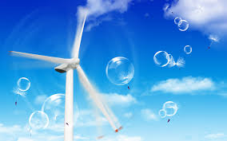
Air
Air is important for living things. Without air, living things cannot survive. Plants use carbon dioxide from air to make food. Again animals need oxygen from the air to breathe.

Slide 5
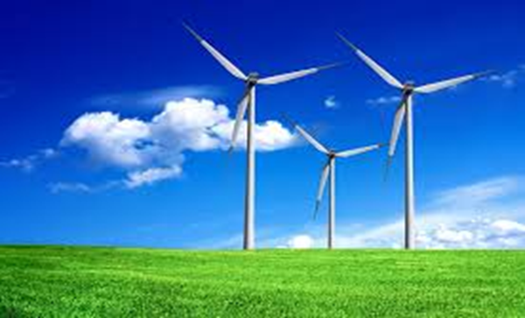
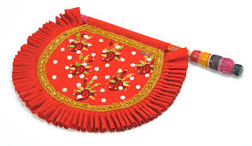
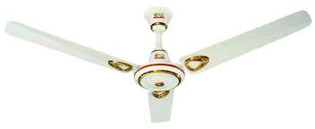
Use of wind
Wind is used to move big wheels or blades of turbine to produce electricity.
People use wind from a hand fan or electric fan to cool themselves.

Slide 6
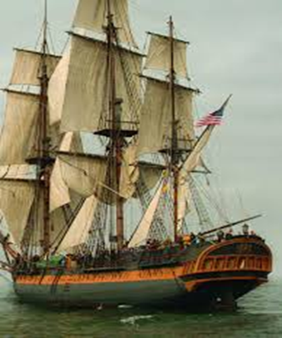
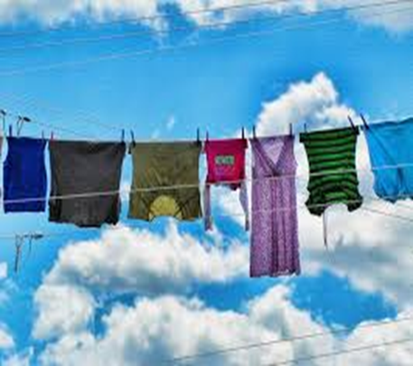
Use of Wind
A sailboat uses wind to travel across the river.
Wind is used to dry something wet because it can take away water from something wet quickly.
We use a dryer to dry wet hair.

Slide 7
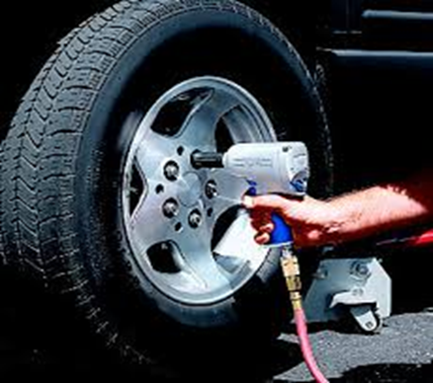
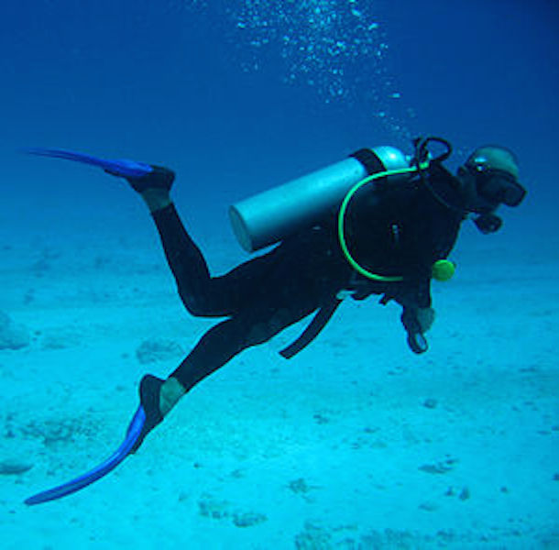
Use of air in daily life
air is used to inflate something such as footballs, tyres of cars, bicycles and rickshaws.
Patients with breathing problems, divers, and alpinists are given oxygen from oxygen cylinder.

Slide 8
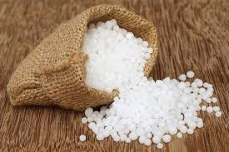
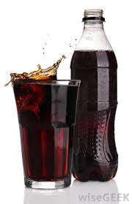
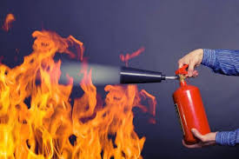
Use of air in daily life
People use nitrogen to make fertilizers called urea, and to preserve foods such as fish, meat and chips in tins or packages.
Carbon dioxide is used in soft drinks such as sodas to give it a fizz, and in fire extinguishers to put out fire.

Slide 9
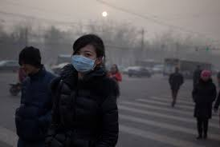
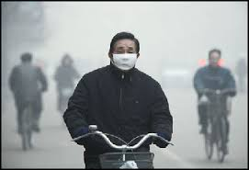
Air Pollution
Air pollution is the introduction of unwanted chemicals, gasses, dust particles, smoke or odour into the air.

Slide 10
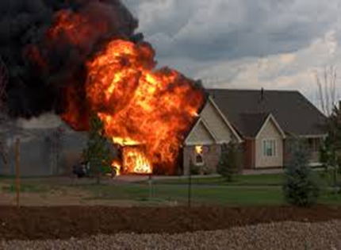
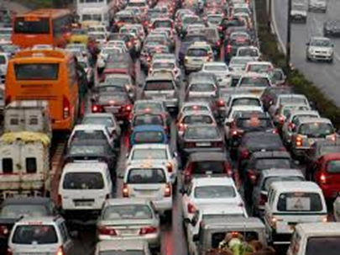
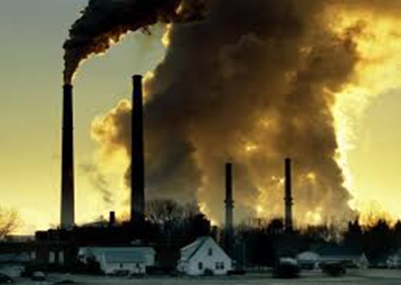
Air pollution
Causes
Human activity
Burning of fossil fuels
Gases come from factories, cars and landfills

Slide 11
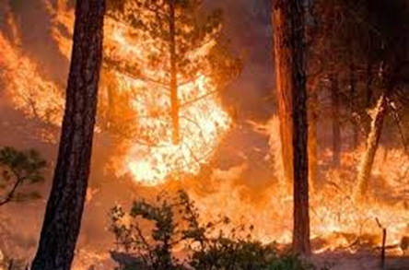
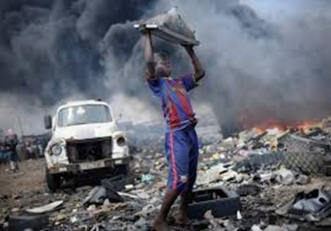
Air pollution
Causes
The smoke from burning wood
Throwing garbage or urinating anywhere causes air pollution.

Slide 12
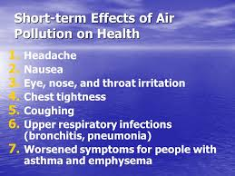
Effects of air pollution on human health

Slide 13
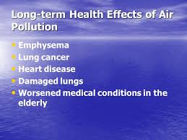
Effects of air pollution on human health

Slide 14
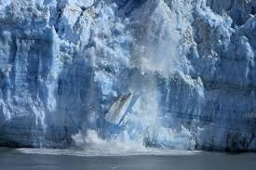
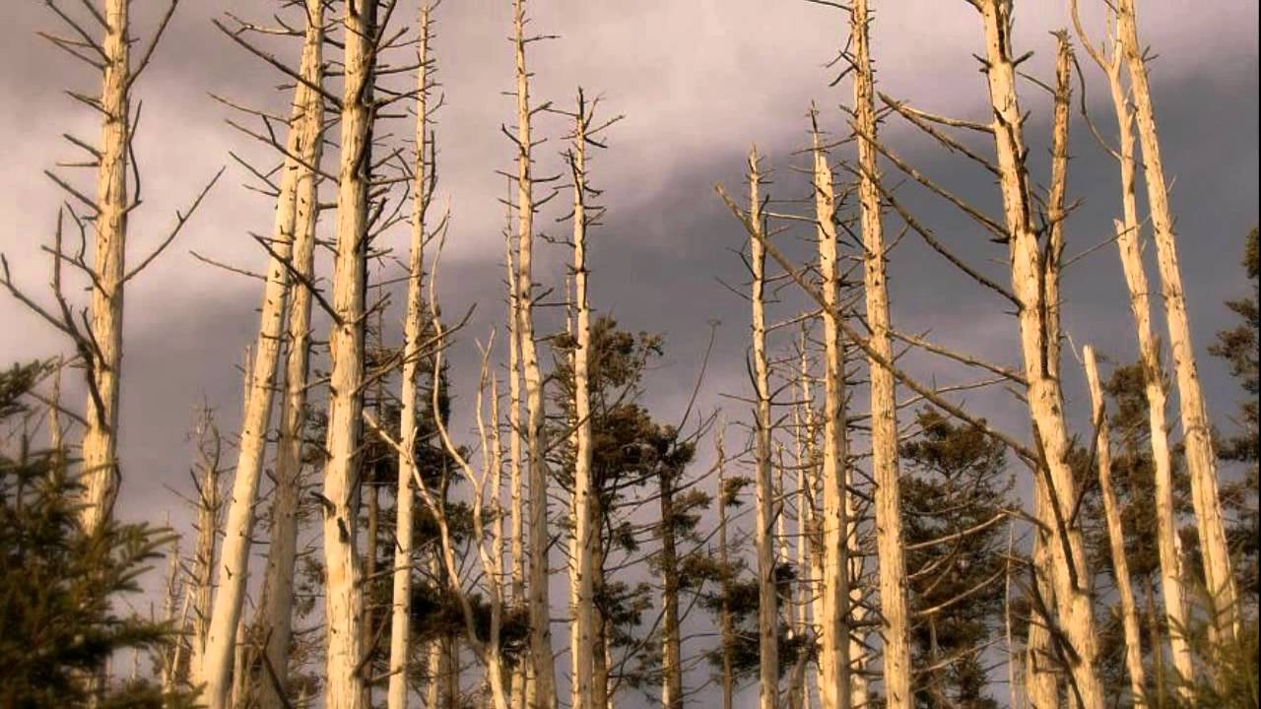
Effects of air pollution on the environment
global warming or acid rain
Due to acid rain living things can be harmed or killed.

Slide 15
Prevention of Air Pollution
Using less energy we can reduce more consumption of fossil fuel.
Turning off the lights

Slide 16
Prevention of Air Pollution
Walking or riding bicycle instead of using car.
Cleaning garbage and planting trees are also good practices to help air clean.

Slide 17
Prevention of Air Pollution
By following 3 R’s like reducing use of natural resources, reusing and recycling to preventing pollution.

Slide 18
THANKS TO ALL

