Slide 1
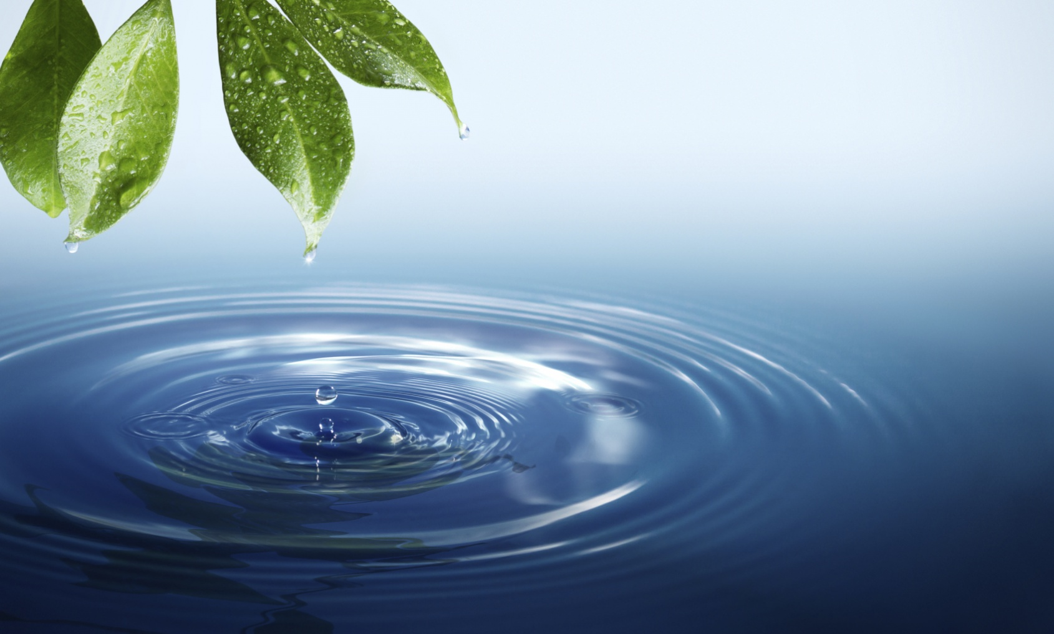
WELCOME

Slide 2
ELEMENTARY SCIENCE Class: Five
Chapter 3
Water for Life

Slide 3
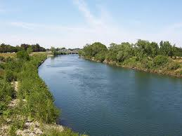
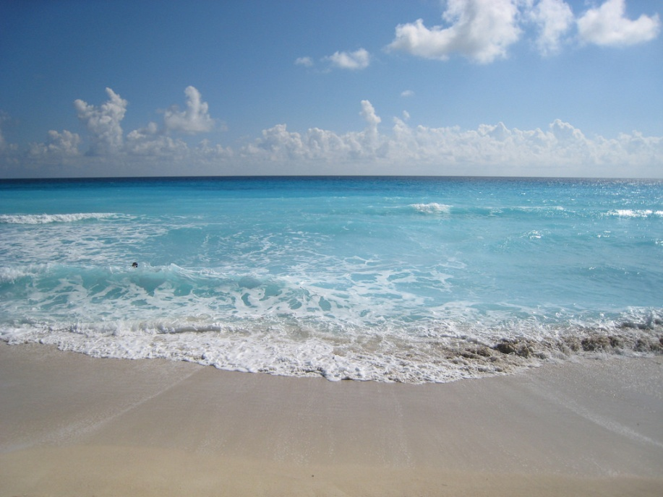
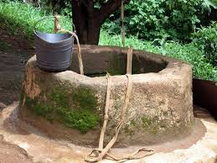
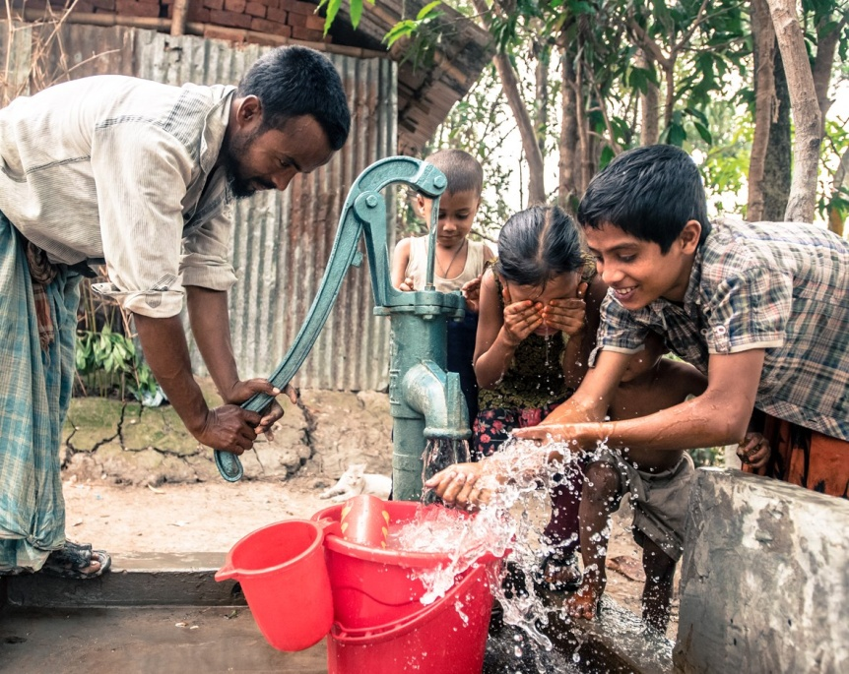
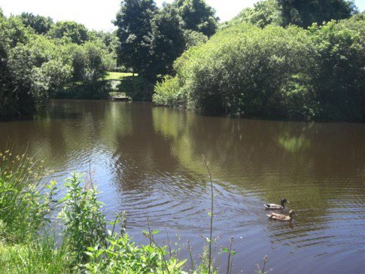
WATER FOR LIFE

Slide 4
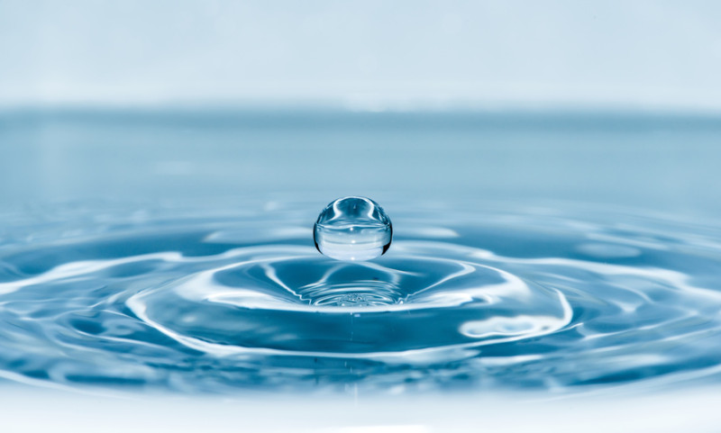
Topics to Discuss
Sources of water
Water for plants and animals
Water cycle
Changing state of water
What is water cycle
Water pollution
Causes
Effects
Preventive measures
Safe water
Ways to get safe water

Slide 5
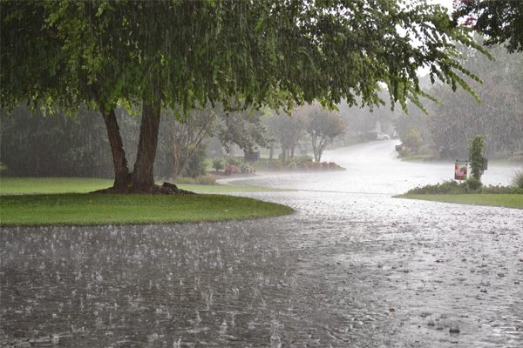
Sources of Water
We are surrounded by water. We can find water from-
Natural sources: rainfall, river, sea etc.
rainfall
river
natural sources of water
sea

Slide 6
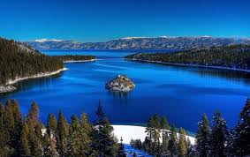
Sources of Water
Man-made sources: lake, pond, well, tube well etc.
lake
pond
well
man-made sources of water
tube well

Slide 7
1.Water for Plants and Animals
Water is essential for living things.
Without water, living things can not survive.
Plants(How do plants use water):
Plants need water for their life.
Plants contain about 90% of water in their bodies.
Plants use water to make their food.
QUESTION: Why do plants and animals need water?
Use of Water

Slide 8
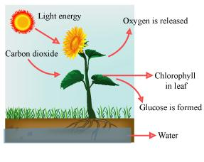
Plants(How do plants use water):
Plants need water for the collection
of nutrients from the soil.
Plants need water to transport the
nutrients into different parts.
Without water, plants cannot
absorb the nutrients from the soil.
Water also plays an important role
of cooling the plants in extreme heat.
Root
Minerals
Plants use water for making food and other purposes

Slide 9
Animals(How do animals use water):
Animals need water to survive.
The human body is made up of about 60-90% of water.
Most animals can survive only for few days without water.
When we eat food , water helps to digest it.
Water helps to carry nutrients to all parts of the body.
Water helps the body to absorb the nutrients.
Water is the essential to maintain proper temperature of our body.

Slide 10
Animals(How do animals use water):
help to carry nutrients
to all parts of the body
help the body to
absorb the nutrients
helps to digest food
maintain proper temperature of our body
We need water to survive

Slide 11
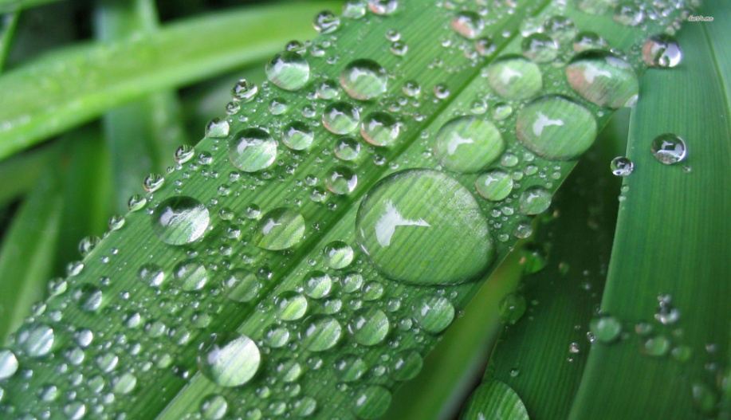
2. Water cycle
Changing State of Water
Have we ever seen the drops of water on the surface of grasses in the morning? Where do the droplets come from?
Can you guess where
the water droplets
come from?
water droplets on the surface of grasses

Slide 12
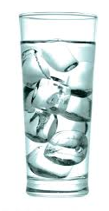
QUESTION: How are the water droplets formed?
Activity: water droplets on the glass
What to Do:
1. Prepare two clean glasses, water, and ice cubes.
2. Pour room temperature water into two glasses, and then
put ice cubes in one glass.
3. After a while, observe the surface of two glasses.
Glass A: room temperature water
Glass B: water with ice cubes

Slide 13
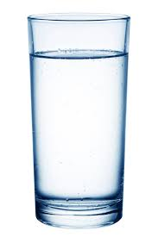
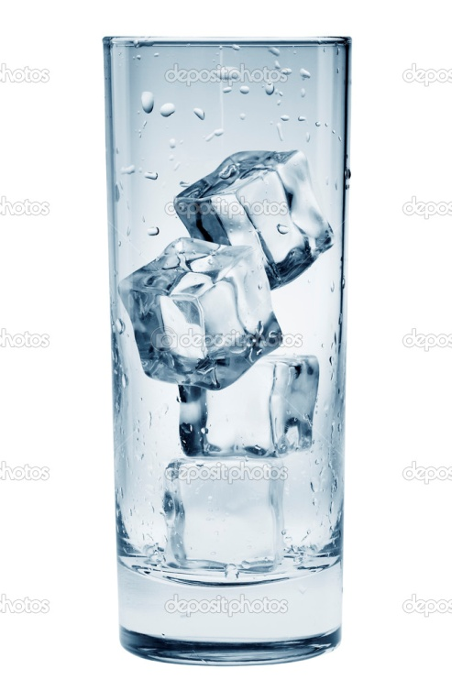
(1)Changing State of Water Result
We found the droplets of water on the surface of glass B. On the other hand, the droplets were not found on the surface of glass A.
Water droplets
Glass A: room temperature water
Glass B: water with ice cubes

Slide 14
(1)Changing State of Water Discussion
Think about the following points based on the result:
Glass A Glass B
What condition is different between two glasses?
Can you guess where the droplets come from? How?

Slide 15
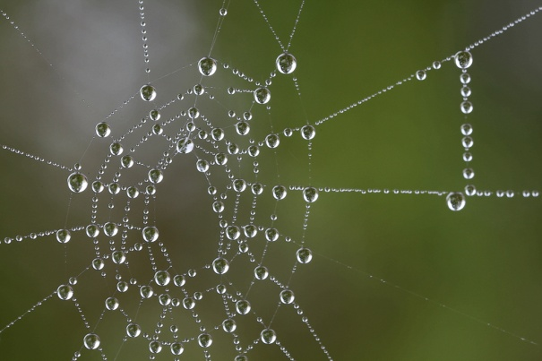
(1)Changing State of Water Summary
Dew: The drops of water that form on cool surface such as grass and leaves at night are called dew.
How dew are formed?
When the air comes into contact with some cold surface such as leaves or grass, water vapour in the air forms into water droplets on that cold surface. Water vapour in the air is changed into water by cooling.
Condensation: The process of changing
state from a gas to liquid is called condensation.
Water vapour in the air is changed into water
by cooling.
Evaporation: The process of changing
state from a liquid to gas is called evaporation.
When water is heated, it changes into water vapour.
dew on spider web

Slide 16
heating
heating
cooling
cooling
Water changes its state

Slide 17
(1)Changing State of Water Summary
Changing state of water:
The state of water is changed due to heating and cooling.
When ice is heated, it changes into water.
When heat is added to water, it evaporates and changes into water vapour.
When water vapour is cooled, it condenses to form water.
When water is cooled, it freezes and becomes ice.

Slide 18
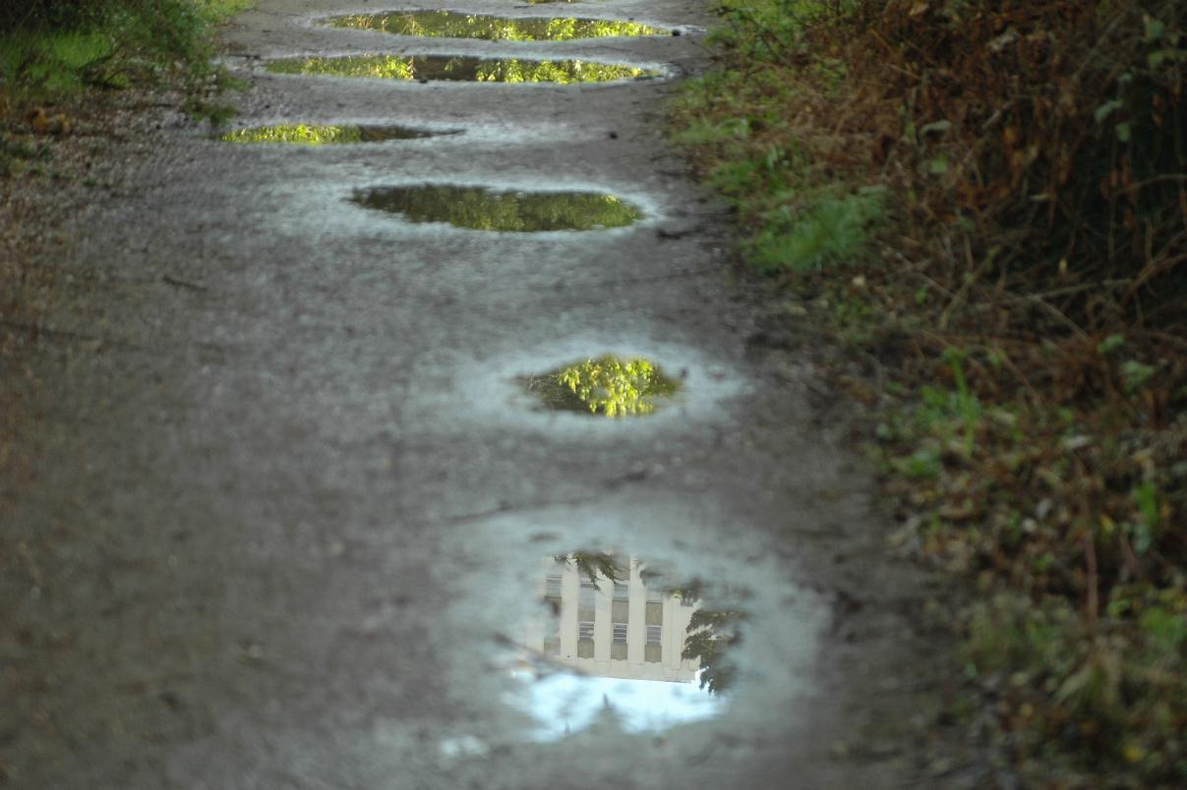
(2) What is Water Cycle?
After rain, there is a puddle of water on the ground. After a short time, the puddle of water disappears.
Where has the water gone?
Can you guess where the
puddle of water has gone?
Water from the rainfall either is absorbed into the ground or runs off into rivers.

Slide 19
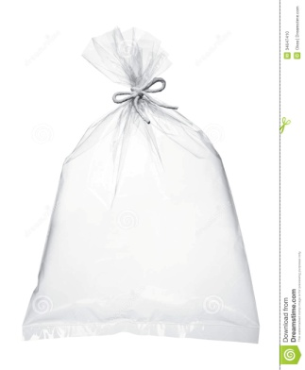
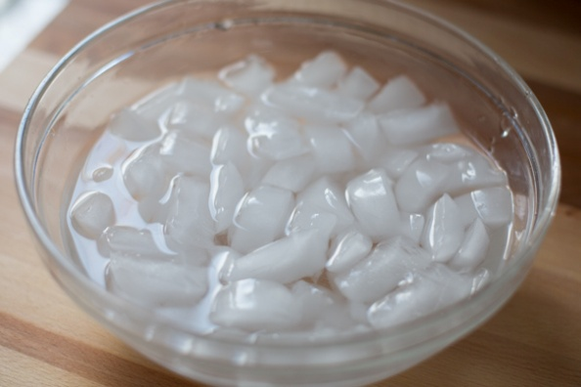
QUESTION: Where does water go and come from?
Activity: Water in the air
What to Do:
Prepare a clear plastic bag, and a vessel filled with ice water.
Catch the air with a clear plastic bag and tie the bag closed tightly.
Put the bag into the vessel for a while, and then take it out from the vessel.
Observe the inside of the bag.

Slide 20
(2) What is Water Cycle? Discussion
Think about the following points based on your observation:
What happened to inside of the bag? Why?
Can you guess what the air has?
air has water vapour

Slide 21
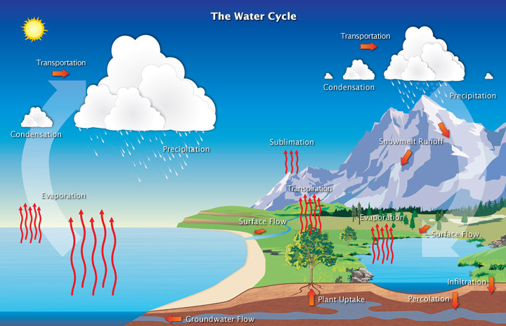
(2) What is Water Cycle? Summary
We have already known from the experiment that air has water vapour.
Water of the earth surface mostly evaporates due to the heat of the sun and get into the air.
This means that the water changes its state from liquid to water vapour.

Slide 23
Water cycle
The way that water moves all around the Earth as it changes its state is
called the water cycle.
State of water is always changing through this cycle. Water in oceans
and rivers evaporates and becomes water vapour. As water vapour rises
in the air, it cools and condenses into tiny droplets. These tiny droplets
accumulate and form clouds.
Large water droplets fall back to the Earth as rainfall. In arctic countries
snow also fall from cloud to the earth.
Water from the rainfall either is absorbed into the ground or run off into
rivers. Water absorbed into ground becomes groundwater . Water that
runs off into rivers flows to sea where it evaporates back into the air.

Slide 24
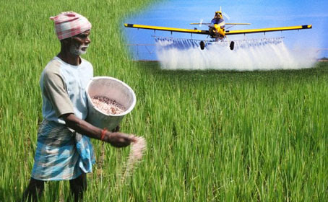
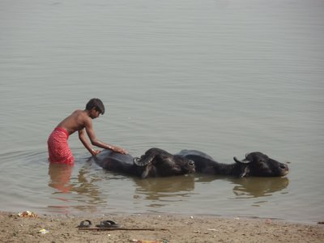
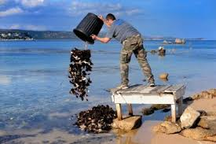
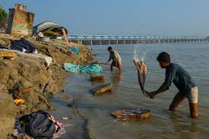
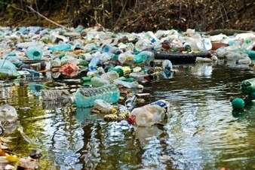
3. Water Pollution
throwing garbage
bathing cattle
using insecticide
washing clothes
throwing household wastes
dumping trash

Slide 25
3.Water pollution
Water pollution is the addition of harmful substances to
water. Water pollution is harmful for living things.
The Causes of Water Pollution
Water pollution is mainly caused by human activity.
Water pollution caused by—
insecticide in agriculture
waste water and chemicals from factories
waste and trash from household
bathing cattle in the river and pond
washing clothes and utensils in the river or pond

Slide 26
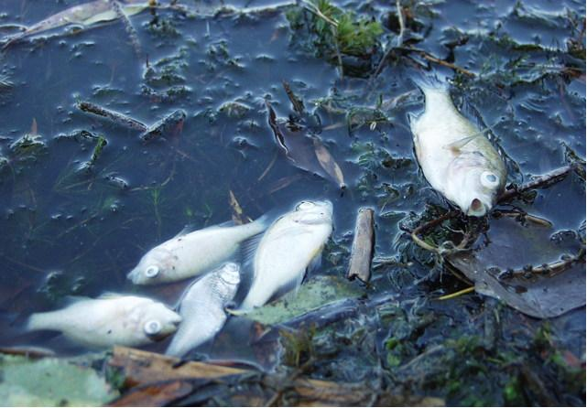
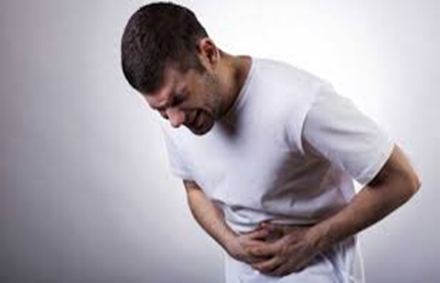
Effects of Water Pollution
Water pollution cause death of
aquatic animals.
Water pollution cause disruption
of water food chain.
Human health affected
by water pollution.
When human drink contaminated
water, they get waterborne diseases
such as diarrhoea and cholera.
death of aquatic animals

Slide 27
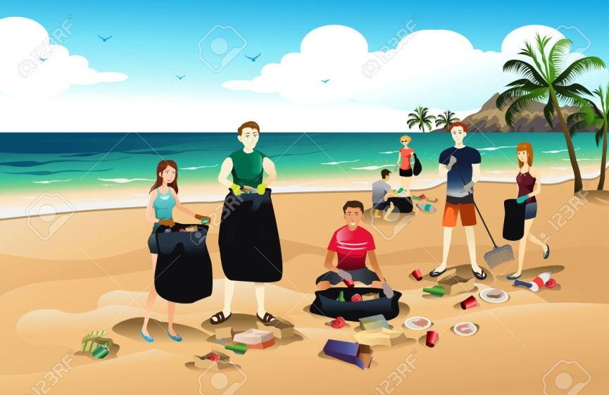
How to Prevent Water Pollution
We can prevent water pollution by reducing the use of pesticides and chemical fertilizers in agricultures.
We should not throw chemicals and oils down the sink drain or the toilet.
We should not throw trash into ponds, rivers, lake or seas.
Picking up trash at the beach,
lake or river helps keeping water
clean.
QUESTION: How can we prevent
water pollution?
picking up trash helps clean water

Slide 28
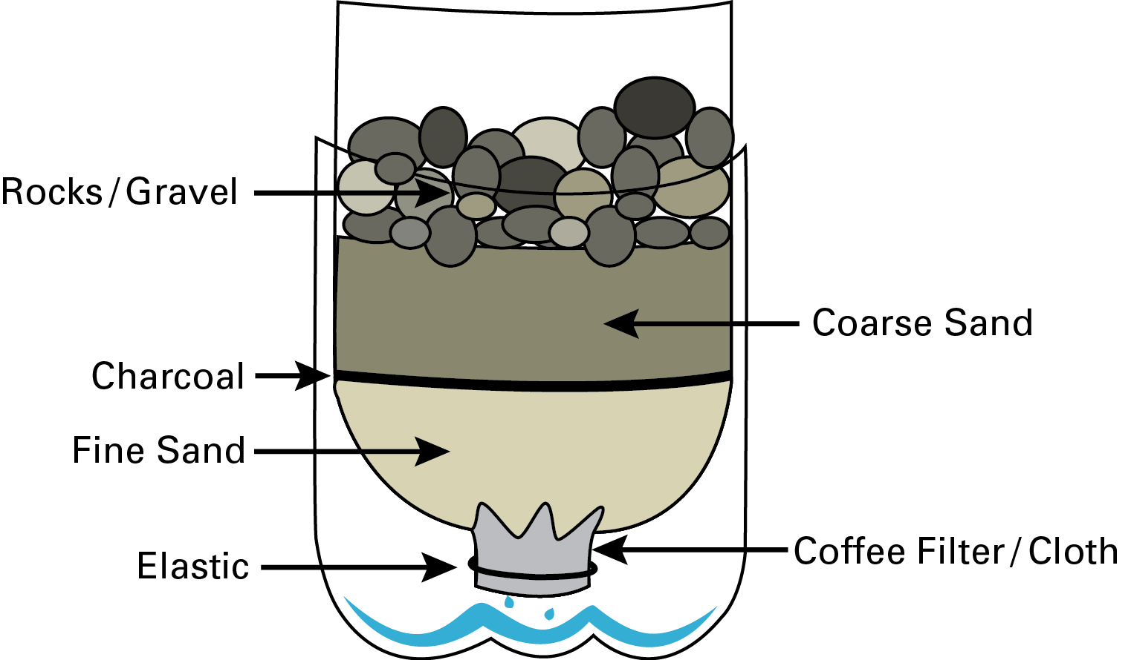
4. Safe Water
The safe water is necessary not only for plants and
animals but also for people to stay healthy.
Activity: Simple water filter
What to Do:
1. Prepare enough dirty water from pond or river,
a plastic bottle, a thin cloth, sand, large gravel
or small rocks, and clear glass.
2. Make a water filter as shown in the picture.
3. Set up the filter, and pour the dirty water into
the filter.
4. Observe the water that passed through the filter.
QUESTION: How can we get safe water?
simple water filter

Slide 29
4. Safe Water
The safe water is water that will not harm people.
Some fresh water is safe to drink for people such as
water from tubewell.
Some fresh water is not safe for people, such as water
from ponds and rivers.
So, it is important to purify water before
we drink and use it for cooking.
Water purification is a treatment of
water to make it safe and acceptable
for human use.
clean but unsafe fresh water

Slide 30
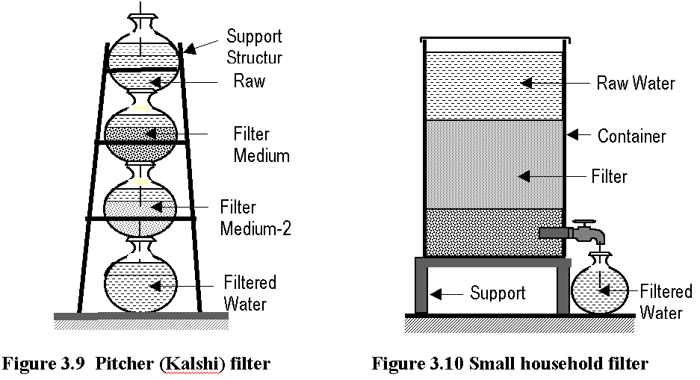
Ways to Get Safe Water
The following shows the ways to get safe water from
unsafe fresh water.
1.Filtration
Filtration is the process of filtering water with filter .
Water may be cleaned by filtration through a thin cloth or
filter.
Though we get clean water in
this way, it is not free from germs.
The filtered water must be
boiled to make it free
from germs.
process of filtration

Slide 31
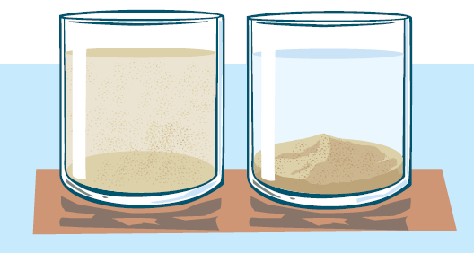
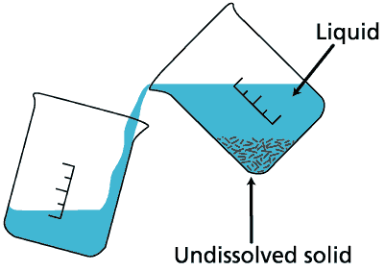
Ways to Get Safe Water
2. Sedimentation
Pour water from pond or river into a pitcher or container,
and leave it for a while. We will see some particles settle at
the bottom of the pitcher or container. The water in the
upper part of pitcher or container is clean.
A water treatment process to remove
suspended particles such as mud and
sand from water is called sedimentation.
sedimentation process

Slide 32
Ways to Get Safe Water
3. Boiling
Boiling is one of good way to make water free
from germs. Water should be boiled in sealed
pot to kill the germs for more than twenty
minutes.

Slide 33
Ways to Get Safe Water
4. Purifying Water with Chemicals
Sometimes due to floods or tidal bores, it is not possible
to boil water. In such situations, we can purify the water
by using prescribed amount of some chemicals such as
alum, bleaching power, and water purifying tablet
(halogen).
However, we should remember that arsenic
contaminated water can not be purified by these
treatment.

