Slide 1
WELCOME

Slide 2
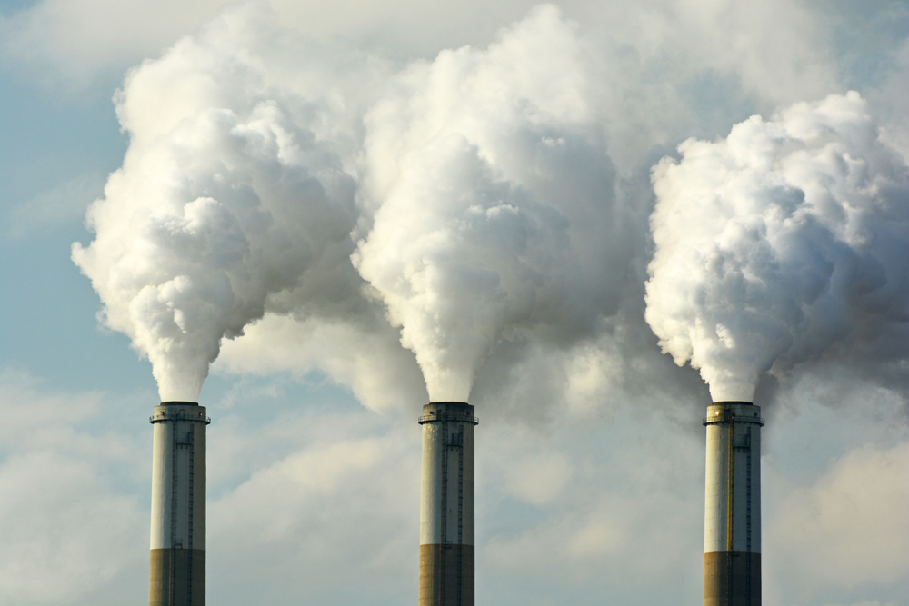
ELEMENTARY SCIENCE
Class: Five
Chapter 2
Environmental pollution

Slide 3
Topics to Discuss
Environmental Pollution.
Cause, Sources and Effects of Environmental Pollution.
Different Kinds of Environmental Pollution.
Cause, Sources and Effects of Different Kinds of Environmental Pollution.
Way of Conservation of Energy.

Slide 4
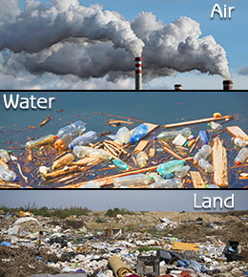
Environmental Pollution
Environmental changes harmful to living things. Environmental pollution is caused by the introduction of harmful and poisonous substances into the environment.

Slide 5
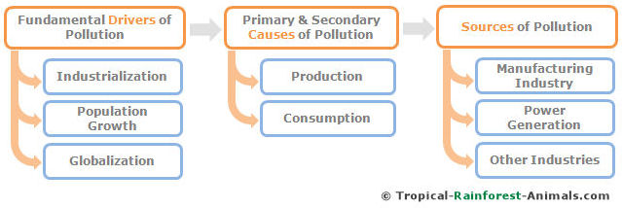
Causes of Environmental Pollution
Industrialization
Population growth
Human activities

Slide 6
Sources of Environmental Pollution
Uses of fossil fuels such as oil, gas and coal in industry are the main source of pollution.

Slide 7
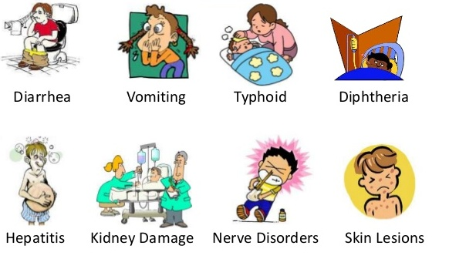
Effects of Environmental Pollution
Effects on Human Beings
i. cancer ii. respiratory diseases
iii. waterborne diseases
iv. skin problems

Slide 8
Effects of Environmental Pollution
Effects on Animal
destruction of animals habitats
destruction of food chains which leads to extinction of many animals.

Slide 9
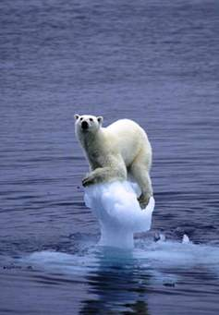
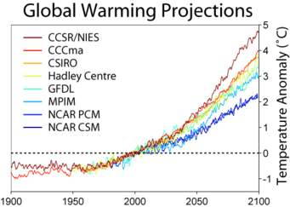
Effects of Environmental Pollution
Effects on Environment
average temperature of the earth is gradually increasing
many glaciers continue to melt and results in sea level rise

Slide 10
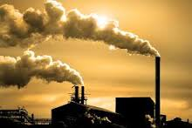
Types of Environmental Pollution which effect the environment are:
Air pollution
Water pollution
Soil pollution
Noise pollution

Slide 11
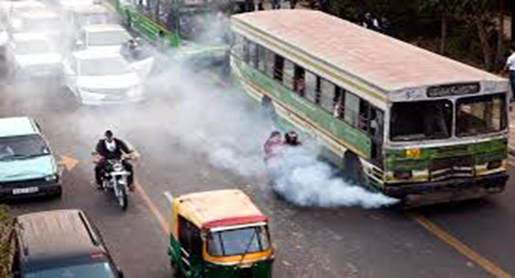
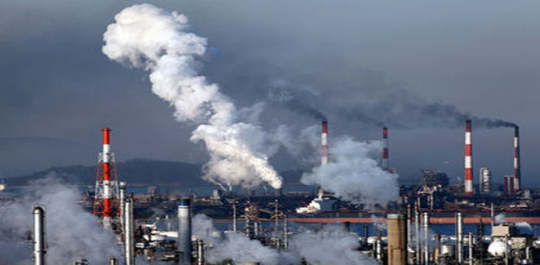
Air pollution
Causes
Air pollution is the action of harmful gases, dust particles, smoke or odour into the air.
Smoke emitted from vehicles and industries is one of the main causes of air pollution.

Slide 12
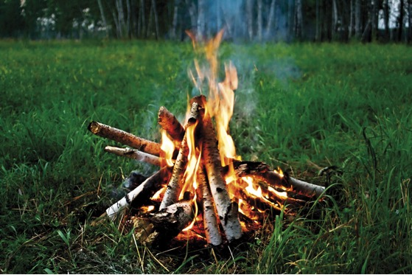
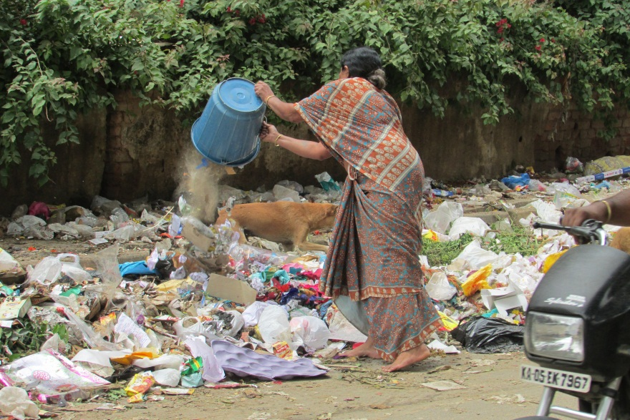
Air pollution
Causes
Smoke emitted from burning wood and garbage also causes air pollution.
Throwing garbage or urinating anywhere causes the foul odour in the air.

Slide 13
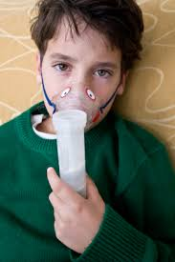
Air pollution
Effects
Air pollution can have negative effects on the environment, such as global warming and acid rain.
It can make people sick with
lung cancer, respiratory diseases etc.

Slide 14
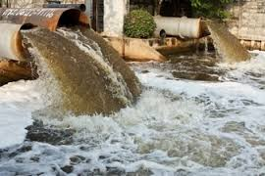
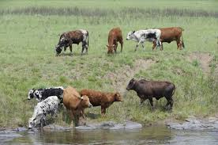
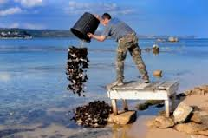
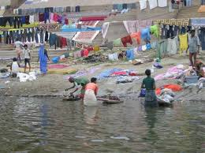
Causes of Water pollution

Slide 15
Water pollution
Causes
Water pollution is the addition of harmful things to water.
Water pollution is caused by harmful things from sewage, waste water from household or factories.
Disposal of garbage and waste into water, and washing clothes in ponds or rivers cause water pollution.

Slide 16
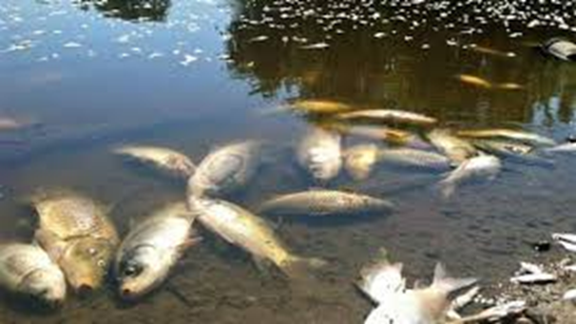
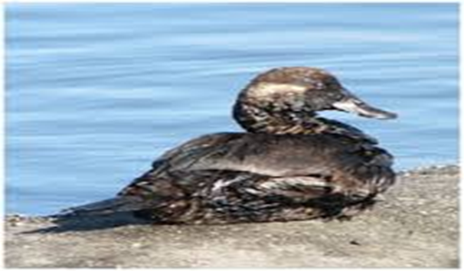
Water pollution
Effects
Water pollution can cause death of aquatic animals and disruption of food chains in water.

Slide 17
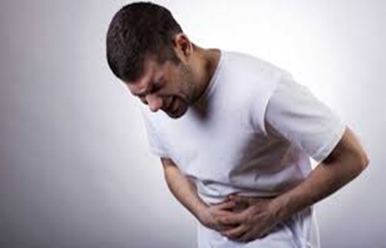
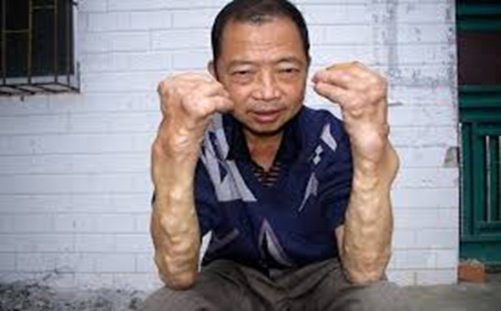
Water pollution
Effects
Human is affected by water pollution such as skin disease and waterborne diseases like diarrhea or cholera.

Slide 18
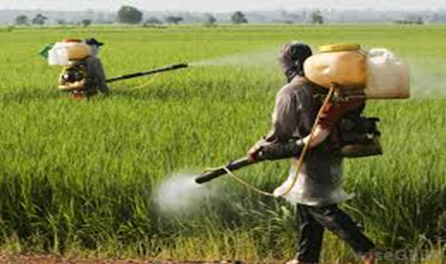
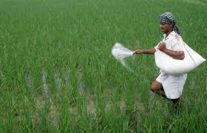
Causes of soil pollution
Soil contamination is caused by the use of pesticides and fertilizers in agriculture.

Slide 19
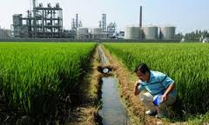
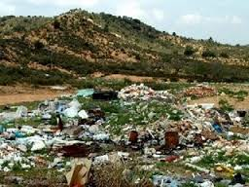
Causes of soil pollution
Waste disposal from household and hospital, and leakage of chemicals or oils from factories.

Slide 20
Soil pollution
Effects
Effects of soil pollution are decreased soil fertility, death of plants and animals and destruction of their habitats.
People may get sick with various diseases including cancer by taking those foods grown in polluted soil.

Slide 21
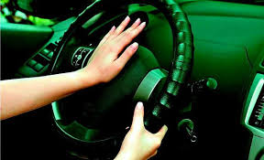
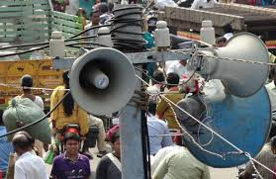
Noise pollution Noise pollution is sound in the environment that harms the health of human or animal life.
Causes
People causing noise pollution by unnecessary use of horns, playing songs in high volume and use of loud speakers or mikes.

Slide 22
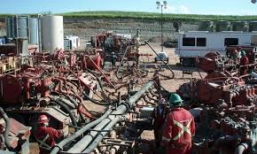
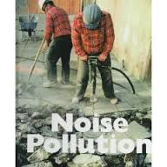
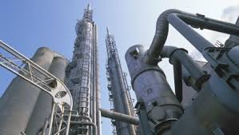
Noise pollution
Causes:
Using big machinery in industries also causes noise pollution.

Slide 23
Effects of Noise pollution
Noise pollution has severe mental and physical effect on human health.
Depression, hearing loss, sleep disruption, and loss of productivity are caused by noise pollution.

Slide 24
Noise pollution
Prevention
We can prevent noise pollution by stopping the frequent use of horns, and turning the volume down.

Slide 25
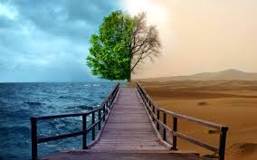
Conservation of Our Environment
Environmental conservation is the sustainable and wise use and preservation of natural environment.

Slide 26
The Ways of Environmental Conservation
By reducing the use of electricity or fossil fuel
Turning off the lights after finishing the work
walking or riding a bicycle instead of using a car

Slide 27
The Ways of Environmental Conservation
Following 3R’s, like reducing the use of natural resources, reusing or recycling we can help conserving nature.
We should not keep the tap running when not in use.
Oils, chemicals and industrial garbage should go through treatment before throwing off into the environment.

Slide 28
The Ways of Environmental Conservation
We should not throw trash into rivers and lakes, or on land.
Dumping garbage in the dustbin and planting trees are good practices to keep our environment clean.
Raising public awareness is one of the best ways to conserve our environment.

Slide 29
THANKS TO ALL

